Slide 1
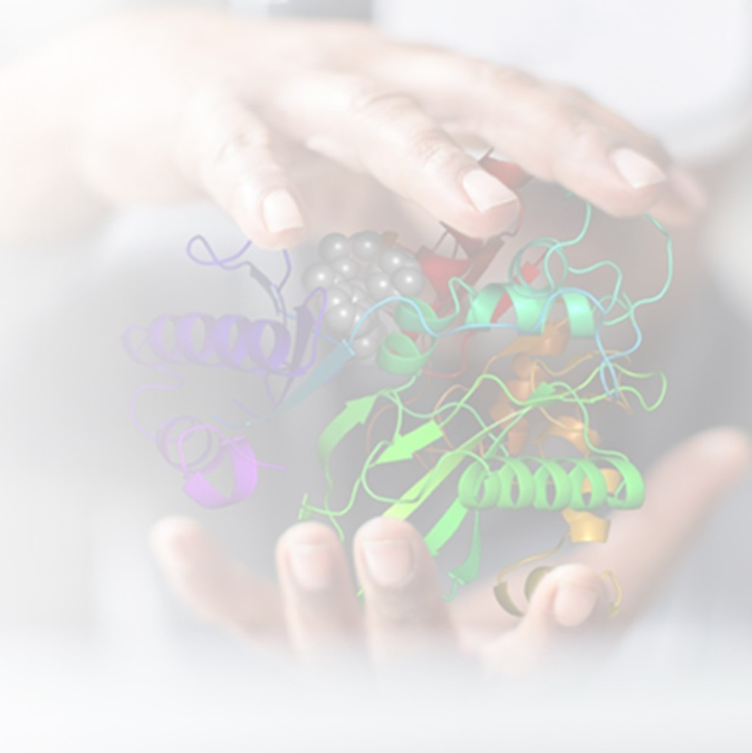
Hands-on Workshop on
“Computationally-Driven
Drug Design Workflows”
Date: November 16-17, 2023
Venue: F-206, BITS Pilani Hyderabad CAMPUS
APPLICATION DEADLINE : November 9, 2023
Seats are limited
Selection is based on eligibility criteria (Master’s students, Ph.D. students, postdocs, researchers, etc.) and a small writeup
Application form link: https://forms.gle/gMB1PRJBUnGrrrYd9
Applicants will be shortlisted and notified for registration
If many good quality applications are received, registration will be offered on a first come, first served basis
No accommodation and transport will be provided
Laptop with Windows 10 or higher & 4GB RAM and higher; Internet will be provided
Registration Fee: ₹ 1000 (includes lunch and refreshments)
Organizers
• Prof K. N. Mohan • Prof Amartya Sanyal
Department of Biological Sciences, BITS Pilani Hyderabad Campus
Speakers from Schrödinger
• Vinod Devaraji • Dr. Koushik Kasavajhala • Dr. Pritesh Bhat
Contact: bio.office@hyderabad.bits-pilani.ac.in

Slide 2
Program Details
Day 1
9:00 AM Breakfast
9:30 AM Technical Setup and Visual check
9:40 AM Inauguration
10:00 AM 1. Opening: Molecular Modelling: Introductory Presentation
10:30 AM 2. Logging into Cloud instance
10:45 AM 3. Maestro GUI 1: 2D Sketcher and 3D Builder
11:15 AM 4. Maestro GUI 2: Building DNA and Importing SMILES
11:45 AM 5. Maestro GUI 3: Protein Visualization 6B2Q
12:15 PM 6. Protein Preparation and Grid Generation 6B2Q
1:00 PM – 2:00 PM Lunch Break
2:00 PM 7. Ligand Preparation for 6B2Q
2:10 PM 8. Molecular Docking 6B2Q
2:40 PM 9. Molecular Docking Analysis 1 – Pose visualization and evaluation
3:15 PM 10. Molecular Docking Analysis 2 – Ligand Interaction Diagram and Calculation of Interaction Fingerprints
3:45 PM Review Day 1 Activities and Completion of tasks
4:00 PM Tea and Snacks
Day 2
9:00 AM Breakfast
9:30 AM Overview of the Department of Biological Sciences
10:00 AM 1. Opening - Molecular dynamics theory presentation
10:30 AM 2. Logging into cloud instance
10:45 AM 3. Protein Preparation
11:15 AM 4. Desmond Introduction and building your MD simulation system
11:45 AM 5. Desmond Molecular Dynamics Submission
12:00 Noon 6. Desmond Molecular Simulation Analysis 1 – Visual Analysis
12:30 PM 7. Desmond Molecular Simulation Analysis 2 – Quantitative Analysis using Simulation Interaction Diagram
1:00 PM – 2:00 PM Lunch Break (Continue to use software during the break)
2:00 PM 8. Ligand Designer
3:00 PM Review Day 2 Activities
3:30 PM Completion and Concluding Remarks
4:00 PM Tea and Snacks
4:30 PM Departure

