Slide 1


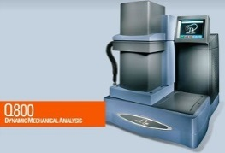
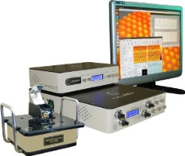
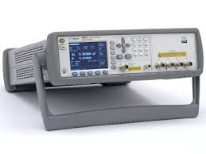
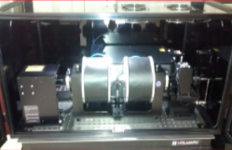
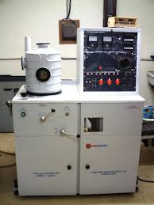
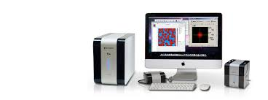
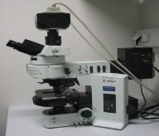
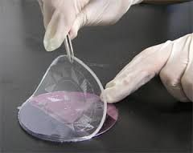
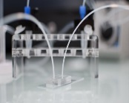
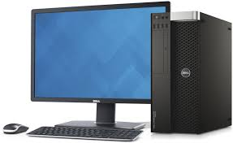
Department of Physics Admissions to Ph.D. Programme, I - Sem 2026 - 2027 (Full - Time and Part - Time)
ABOUT THE DEPARTMENT
25 faculty members with expertise in different research areas.
43 Ph.D. students currently pursuing research in the department.
Seven of our recent Ph.Ds are doing post-doctoral research in reputed institutions in India and abroad.
For more details: https://www.bits-pilani.ac.in/hyderabad/physics/
RESEARCH AREAS
High Energy Physics
Astrophysics* (General Relativity, Gravitational Physics)
Theoretical Physics* (Quantum Dissipation and QFT, Statistical Mechanics and Computational Soft Matter*)
Experimental Condensed Matter Physics
(Spintronics in Nanomagnets*, Quantum Devices and Low-Dimensional Quantum Materials, Multiferroic Materials, Renewable Energy, Photovoltaics*)
Quantum Optics, Modeling Quantum Devices*
Biophysics and Biomaterials*
* Admission for I - Sem 2026 - 2027 is planned only for these research areas.
APPLICATION & SELECTION PROCESS
Selection is made through an entrance test followed by an interview (M.E/ M.Tech/ M.Phil/ NET/ GATE qualified candidates are exempted from the entrance test).
Full-time Ph.D. scholars will be considered for Project/Research Assistantship of Rs. 37,000/- per month, which may be increased to either Rs. 40,000/- or 42,000/- per month based on performance. In addition to their research work, they will be required to participate in teaching and other related activities of the institute.
Apply online with required documents. For more details, please visit
https://admissions.bits-pilani.ac.in/PhD/phd.html
ELIGIBILITY
Minimum 60% marks in M.Sc (Physics/ Maths/ Materials science/ Electronics/ Nanotechnology) or BE /B.Tech (any branch)
Admission will be based on a written test and interview (M.E/ M.Tech/ M.Phil/ NET/ GATE qualified candidates are exempted from the entrance test)
IMPORTANT DATES
Last date for applying: 29th APRIL 2026
Shortlisted candidates will be called for the test/ interview.
Contact (Hyderabad Campus)
Off: +91 4066303830 Email: admissions@hyderabad.bits-pilani.ac.in
Dynamic Mechanical Analyzer | Scanning Tunneling Microscope | AC Impedance Analyzer | Faraday Rotation Measurement Unit | Thin Film Deposition Unit | Atomic Force Microscope | Fluorescent Microscope | Soft Lithography Fabrication Unit | Server for Computation

