Slide 1
High-Level Synthesis (HLS)
Vipin Kizheppatt
28/10/2024

Slide 2
Introduction
When the circuits were small, hardware designers could specify every transistor, and everything was done manually
As our ability to manufacture more transistors increased, hardware designers began to rely on automated design tools
These tools gradually become more and more sophisticated and allowed hardware designers to work at higher levels of abstraction
Register-transfer level (RTL) was one step in abstraction

Slide 3
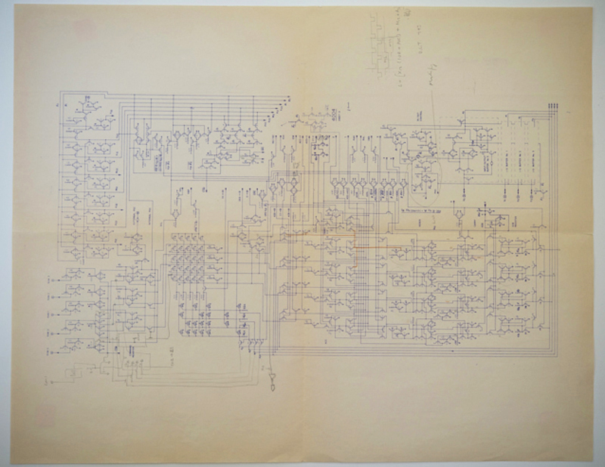
Introduction
Hand drawn schematic (by Federico Faggin) of the ALU of the first micro processor (4004)

Slide 4
RTL
EDA tools can translate RTL specifications into a digital circuit model and then subsequently into the detailed specification
High-level synthesis (HLS) is yet another step in abstraction that enables a designer to focus on larger architectural questions rather than individual registers and cycle-to-cycle operations
An HLS tool creates the detailed RTL micro-architecture from a high-level language
Most of the commercial tools now use C/C++ as the input language

Slide 5
HLS
Algorithmic HLS does several things automatically that an RTL designer does manually
→ analyzes and exploits the concurrency in an algorithm
→ inserts registers as necessary to limit critical paths and achieve a desired clock frequency
→ implements interfaces to connect to the rest of the system
→ Maps data onto storage elements to balance resource usage and bandwidth
→ Maps computation onto logic elements performing user specified and automatic optimizations to achieve the most efficient implementation

Slide 6
Vitis HLS
The goal of HLS is to make these decisions automatically based upon user-provided input specification and design constraints
The designer is expected to supply the HLS tool a functional specification, describe the interface, provide a target computational device, and give optimization directives
Vitis HLS requires the following
→ A function specified in C, C++, or SystemC
→ A design testbench that calls the function and verifies its correctness by checking the results
→ A target FPGA device
→ The desired clock period
→ Directives guiding the implementation process

Slide 7
HLS
HLS tools cannot handle arbitrary software code
→ For example usually they cannot implement dynamic memory allocation
→ Limited support for standard libraries
→ System calls are usually avoided
→ Ability to perform recursion is often limited
→ They typically requires additional information provided by designers (#pragmas)

Slide 8
HLS
HLS tools cannot handle arbitrary software code
→ For example usually they cannot implement dynamic memory allocation
→ Limited support for standard libraries
→ System calls are usually avoided
→ Ability to perform recursion is often limited
→ They typically requires additional information provided by designers (#pragmas)
Other hand HLS tools can
→ Deal with variety of interfaces (DMA, streaming, on-chip memory)
→ Perform advanced optimizations (pipelining, memory partitioning, bitwidth optimization)

Slide 9
HLS
The primary output of HLS is an RTL that is capable of being synthesized through the rest of the hardware design flow
The tool will provide some estimates on resource usage and performance
Vitis HLS generates the following outputs
  Synthesizable Verilog and VHDL
  RTL simulations based on the design testbench
  Static analysis of performance and resource usage
Using Vivado Design suite then this RTL can be implemented on the target FPGA

Slide 10
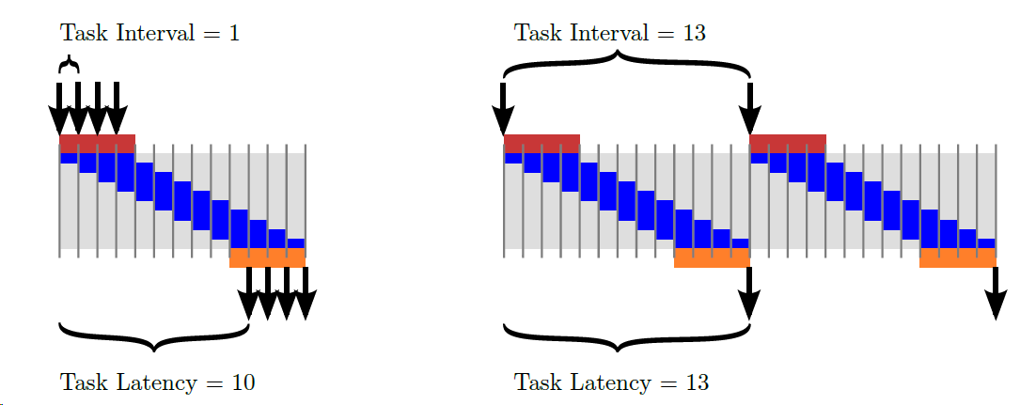
Performance Characterization
We use the term task to denote a function invocation in Vitis HLS
Task latency is the time between when a task starts and when it finishes
Task interval is the time between when one task starts and the next starts or or the difference between the start times of two consecutive tasks

Slide 11
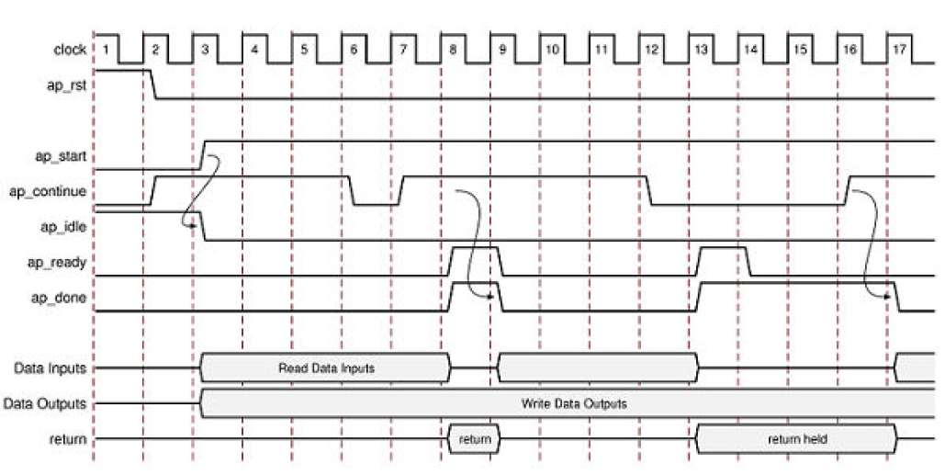
ap_ctrl_hs I/O protocol

Slide 12
ap_ctrl_hs Interface
Signal
ap_rst | Active high reset
ap_idle | A high-value indicates the IP is idle.
ap_start | This signal should be asserted for the IP to start operation. It should be kept asserted until ap_ready is asserted Once ap_ready goes High: If ap_start remains High the design will start the next transaction → If ap_start is taken Low, the design will complete the current transaction and halt operation
ap_ready | Indicates that the IP has received all the data for the required operation
ap_done | Asserted when the IP completes the operation
ap_return | If ap_return is present, ap_done high indicates the value on the bus is valid

Slide 13
Coding Styles for better performance

Slide 14
Performance Calculations
In terms of X bits/second
Y operations/second
MAC operations/sec
Performance requirement is specified in terms of the target clock frequency (and task interval)
Increasing target clock frequency is not necessarily optimal in terms of overall system
Lower frequencies enable operation chaining
This may allow higher performance by improved logic synthesis optimizations and reducing the resource utilization
For zynq 7000 platform, a good starting point for clock frequency will be 100 MHz

Slide 15
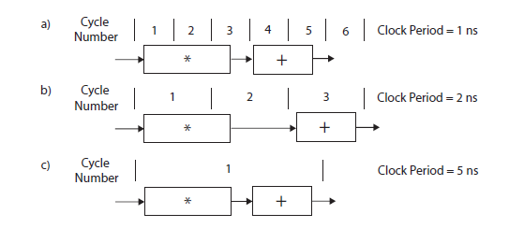
Operation Chaining
Multiply operation requires 3ns and addition requires 2 ns
Then the effect of clock period constraint on throughput
(200 Million MAC/sec)
(167 Million MAC/sec)
(200 Million MAC/sec)

Slide 16
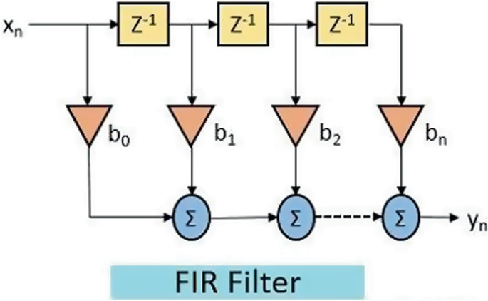
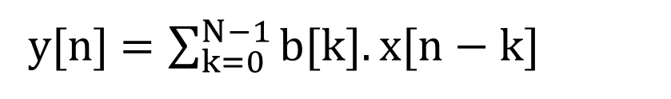
FIR Filter Design
y[n] $=\sum_{k=0}^{N−1}{b[k].x[n−k]}$

Slide 17
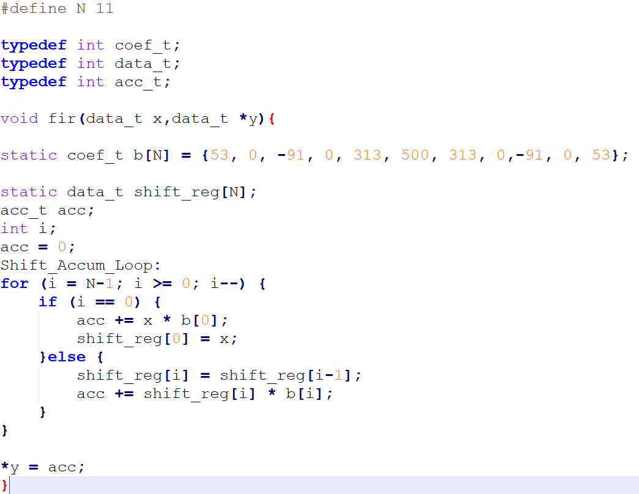
FIR C Code

Slide 18
Code hoisting
If/else statement inside a loop is quite inefficient
For every control statement, HLS generates corresponding hardware logic which executes in each loop iteration
If statement checks when x == 0, which happens only on the last iteration
Therefore, statements within the if branch can be hoisted out of the loop.

Slide 19
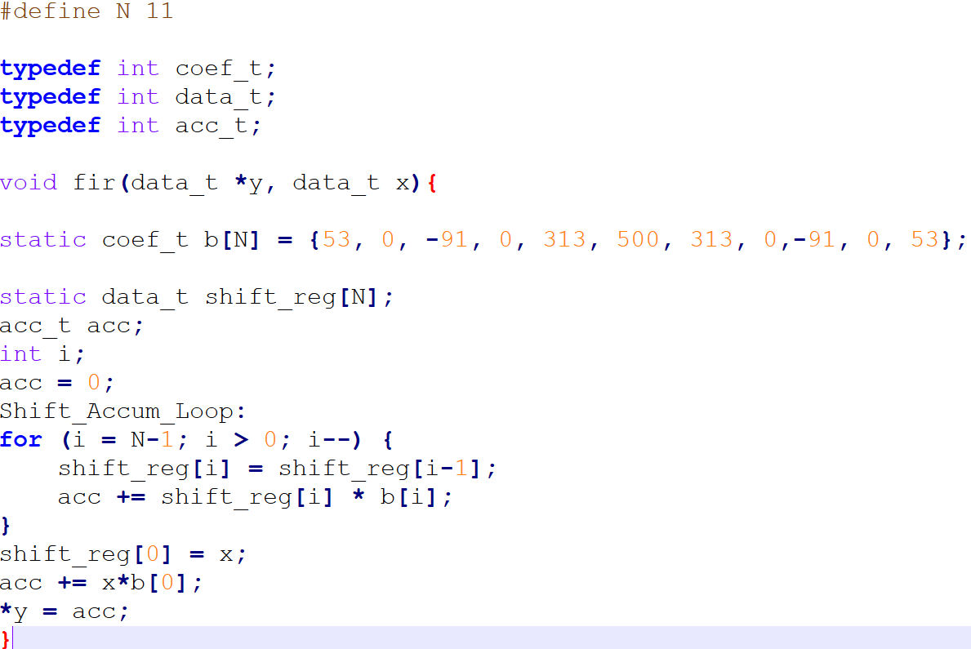
Code Hoisting
Loop bound is changed
Moved out of the loop

Slide 20
Loop Fission
Loop fission takes different operations and implements each of them in their own loop
This enables to apply optimizations independently to the loops
Does not guarantee performance improvement (it may even make performance worse)

Slide 21
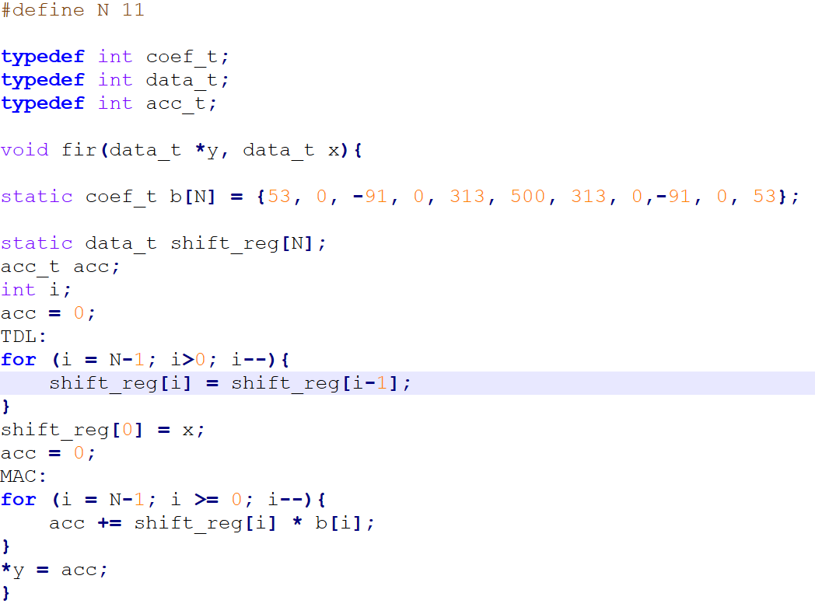
Loop Fission

Slide 22
Loop Unrolling
By default, Vitis HLS synthesizes loops in a sequential manner
Data path is implemented to execute the logic inside the loop once and is repeated with the help of a control logic (FSM)
This is highly area efficient but doesn’t explore the parallelism
Loop unrolling replicates the body of the loop by some number of times called factor
It reduces the number of iterations of the loop by the same factor
Loop unrolling can increase the overall performance provided some (or all) of the statements can be executed in parallel

Slide 23
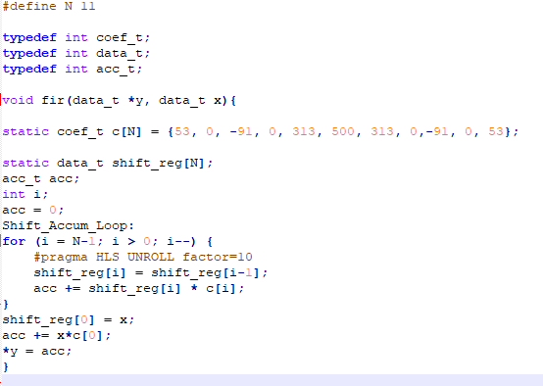
Loop Unrolling (Pragma)

Slide 24
Loop Pipelining
Loop pipelining is an optimization that overlaps multiple iterations of a for loop
Loop initiation interval (II) is an important performance metric here
It is defined as the number of clock cycles until the next iteration of the loop can start
If loop II is 1, which means that we start a new iteration of the loop every cycle
This may not always be possible due to resource constraints and/or dependencies in the code

Slide 25
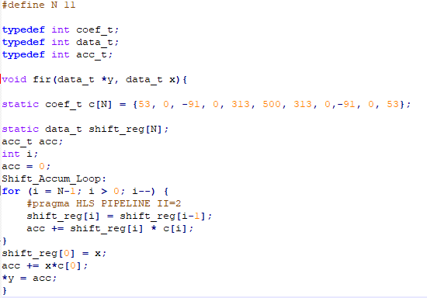
Loop Pipelining (Pragma)

Slide 26
Bitwidth Optimization
C language provides many different data types to describe different kinds of behavior but all of them have a size which is power of 2
In many cases to implement optimized hardware, it is necessary to process data where the bitwidth is not a power of two
Vitis HLS provides arbitrary precision data types which allow for signed and unsigned data types of any bitwidth
Unsigned: ap_uint<width>
Signed: ap_int<width>
the width variable is an integer between 1 and 1024

Slide 27
Bitwidth Optimization
To use these data types your source code should be in C++ (with .cpp extension) need to include the header file “ap_int.h”
#include "ap_int.h“
ap_int<5> add(ap_int<5> a, ap_int<5> b){
return a+b;
}

Slide 28
Thank you any questions

