Slide 1
Free RTOS
Vipin Kizheppatt
14/10/2024

Slide 2
Real-Time Operating Systems
Mostly used in embedded systems
Should be modular and extensible
Kernel must be small since ROM and RAM space may be limited
Some systems are safety critical and require certification including OS
Usually follows microkernel approach providing only essential services, such as scheduling, synchronization, and interrupt handling

Slide 3
Real-Time Operating Systems
Eg.1: VxWorks from Wind River
Used in 2020 Mars Rover, Mars Reconnaissance Orbiter, Boeing 787, BMW iDrive 2.0
Eg.2: Green Hill’s INTEGRITY/INTEGRITY-178B used in B2, F-16, F-22, F-35 military jets and commercial aircrafts such as Airbus A-380
Kernel design guarantees bounded computing times by eliminating features such as dynamic memory allocation
Eg.3: QNX mostly used in automobiles

Slide 4
Free RTOS
Free RTOS is an open source real time operating system currently maintained by Amazon AWS and available under MIT license
It is ideally suited to deeply embedded real-time applications that use microcontrollers or small microprocessors
Applications usually include a mix of both hard and soft real-time requirements
FreeRTOS is a real-time kernel (or real-time scheduler) on top of which embedded applications can be built to meet their hard real-time requirements

Slide 5
Free RTOS
It allows applications to be organized as a collection of independent threads of execution
On a processor that has only one core, only a single thread can be executing at any one time
Kernel decides which thread should be executing by examining the priority assigned to each thread by the application designer
In FreeRTOS, each thread of execution is called a ‘task’

Slide 6
Free RTOS Features
Pre-emptive or co-operative operation
Very flexible task priority assignment
Queues
Binary semaphores
Mutexes
Software timers
Stack overflow checking
Trace recording
Full interrupt nesting model (for some architectures)

Slide 7
Task Functions
Tasks are implemented as C functions
Only thing special about them is their prototype, which must return void and take a void pointer parameter
void ATaskFunction( void *pvParameters );
Each task has an entry point, will normally run forever within an infinite loop, and will not exit
They must not contain a ‘return’ statement
If a task is no longer required, it should instead be explicitly deleted
A single task function definition can be used to create any number of tasks—each created task being a separate execution instance

Slide 8
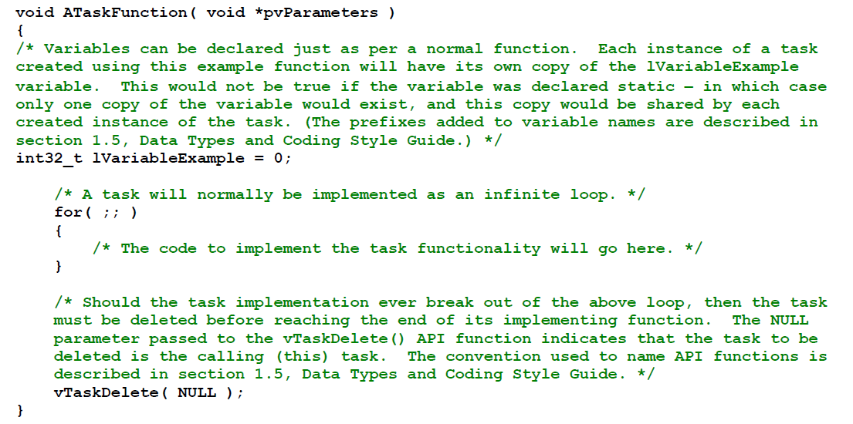
Task Functions

Slide 9
Task States
An application can consist of many tasks
If the processor running the application contains a single core, then only one task can be executing at any given time
This implies that a task can exist in one of two states, Running and Not Running
A task transitioned from the Not Running state to Running state is said to have been ‘switched in’ or ‘swapped in’
Task transitioned from the Running state to Not Running state is said to have been ‘switched out’ or ‘swapped out’
FreeRTOS scheduler is the only entity that can switch a task in and out

Slide 10
Creating Tasks
Tasks are created using FreeRTOS xTaskCreate() API function
BaseType_t xTaskCreate(
TaskFunction_t pvTaskCode,
const char * const pcName,
uint16_t usStackDepth,
void *pvParameters,
UBaseType_t uxPriority,
TaskHandle_t *pxCreatedTask
);

Slide 11
Creating Tasks
Parameter Name/ Returned Value | Description
pvTaskCode | pvTaskCode parameter is simply a pointer to the function that implements the task (in effect, just the name of the function)
pcName | A descriptive name for the task. This is not used by FreeRTOS in any way. May be useful for debugging
usStackDepth | Each task has its own unique stack that is allocated by the kernel to the task when the task is created. The usStackDepth value tells the kernel how large to make the stack. The value specifies the number of words the stack can hold, not the number of bytes.
pvParameters | Task functions accept a parameter of type pointer to void ( void* ). The value assigned to pvParameters is the value passed into the task.
uxPriority | Defines the priority at which the task will execute. Priorities can be assigned from 0, which is the lowest priority, to (configMAX_PRIORITIES – 1), which is the highest priority.

Slide 12
Creating Tasks
Parameter Name/ Returned Value | Description
pxCreatedTask | pxCreatedTask can be used to pass out a handle to the task being created. This handle can then be used to reference the task in API calls that, for example, change the task priority or delete the task. If your application has no use for the task handle, then pxCreatedTask can be set to NULL.
Returned value | 1. pdPASS This indicates that the task has been created successfully. 2. pdFAIL This indicates that the task has not been created because there is insufficient heap memory available for FreeRTOS to allocate enough RAM to hold the task data structures and stack.

Slide 13
Task Priorities
Maximum number of priorities available is set by configMAX_PRIORITIES constant within FreeRTOSConfig.h
Range of available priorities is 0 to (configMAX_PRIORITIES – 1)
Any number of tasks can share the same priority
FreeRTOS scheduler will always ensure that the highest priority task that is able to run is the task selected to enter the Running state
If more than one task of the same priority is able to run, they are scheduled through round robin

Slide 14
Task Priorities
Maximum number of priorities available is set by configMAX_PRIORITIES constant within FreeRTOSConfig.h
Range of available priorities is 0 to (configMAX_PRIORITIES – 1)
Any number of tasks can share the same priority
FreeRTOS scheduler will always ensure that the highest priority task that is able to run is the task selected to enter the Running state
If more than one task of the same priority is able to run, they are scheduled through round robin

Slide 15
Tick Scheduling
Modern RTOS use a clock driven approach for simpler implementation of clock driven scheduling
A timer gives regular (periodic) interrupts at predefined time instances called ticks and each tick acts as a scheduling point
A tick is a predefined duration of time (practically a few milli-seconds)

Slide 16
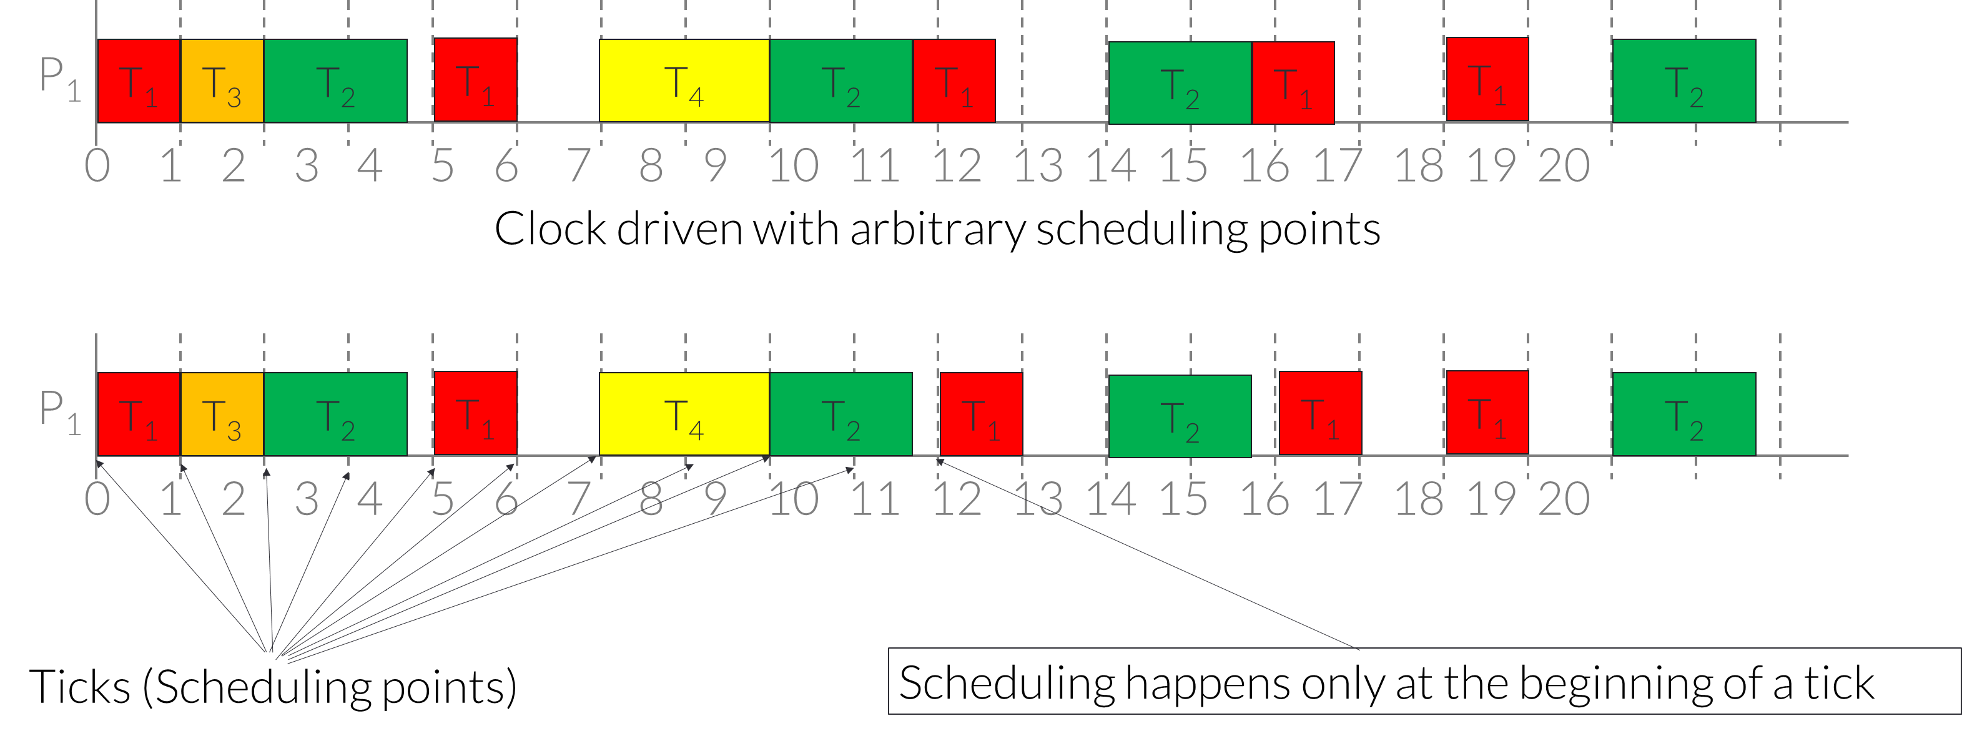
Tick Scheduling
T₁ = (4, 1), T₂ = (5, 1.8), T₃ = (20, 1), and T₄ = (20, 2)

Slide 17
Tick Scheduling
For freeRTOS tick interrupt frequency is configured by configTICK_RATE_HZ constant within FreeRTOSConfig.h
Eg: if configTICK_RATE_HZ is set to 100 (Hz), then time slice will be 10 milliseconds
Optimal value for configTICK_RATE_HZ is dependent on the application being developed, although a value of 100 is typical
FreeRTOS API calls always specify time in multiples of tick periods
pdMS_TO_TICKS() macro converts a time specified in milliseconds into a time specified in ticks

Slide 18
Tick Scheduling
vTaskDelay() places the calling task into the Blocked state for a fixed number of tick interrupts
A task does not use any processing time while it is in the Blocked state

Slide 19
Queue Management
‘Queues’ provide a task-to-task, task-to-interrupt, and interrupt-to-task communication mechanism
A queue can hold a finite number of fixed size data items
Queues are normally used as First In First Out (FIFO) buffers, where data is written to end (tail) of queue and removed from the front (head) of queue
It is also possible to write to front of a queue, and to overwrite data that is already at front of a queue

Slide 20
Queue Management
There are two ways in which queue behavior could have been implemented:
1. Queue by copy
Queuing by copy means data sent to queue is copied byte for byte into queue
2. Queue by reference
Queuing by reference means queue only holds pointers to data sent to queue, not the data itself
FreeRTOS uses the queue by copy method

Slide 21
Queue Management
RTOS takes complete responsibility for allocating the memory used to store data
Any number of tasks can write to same queue, and any number of tasks can read from same queue
When a task attempts to read from a queue, it can optionally specify a ‘block’ time
This is the time the task will be kept in the Blocked state to wait for data to be available from the queue, if the queue is empty
The tasks moves to ready state if data becomes available in queue or the block time expires

Slide 22
Queue Management
If queue has more than one reader blocked, the task with highest priority will be unblocked when data becomes available
If blocked tasks have equal priority, then task that has been waiting for data longest will be unblocked
A task can optionally specify a block time when writing to a queue
Block time is maximum time task should be held in Blocked state to wait for space to become available on the queue if queue is full
If queue has more than one writer blocked, the task with highest priority will be unblocked when space becomes available
If blocked tasks have equal priority, then task that has been waiting for longest will be unblocked

Slide 23
Using a Queue
A queue must be explicitly created before it can be used
xQueueCreate() API function creates a queue and returns a QueueHandle_t that references the queue it created
FreeRTOS allocates RAM from FreeRTOS heap when a queue is created
xQueueCreate() will return NULL if there is insufficient heap RAM available for the queue to be created

Slide 24
Mutexes
A Mutex is a special type of binary semaphore that is used to control access to a resource that is shared between two or more tasks
A mutex can be thought of as a token that is associated with the resource being shared
For a task to access the resource, it must first successfully ‘take’ the token
When token holder has finished with the resource, it must ‘give’ the token back
Only when the token has been returned can another task successfully take the token, and then safely access the same shared resource

Slide 25
Mutexes
Before a mutex can be used, it must be created using xSemaphoreCreateMutex() API function
If NULL is returned then the mutex could not be created because there is insufficient heap memory available
A non-NULL return value indicates that the mutex has been created successfully
SemaphoreHandle_t xSemaphoreCreateMutex( void );

Slide 26
Mutexes
xSemaphoreTake( xMutex, portMAX_DELAY )
xSemaphoreTake() API is used to try to gain access to the token
portMAX_DELAY is the maximum delay the task will wait to get the access
If it cannot access the token with in this period, it will be blocked
xSemaphoreGive(xMutex)
xSemaphoreGive() API is used to return the token

Slide 27
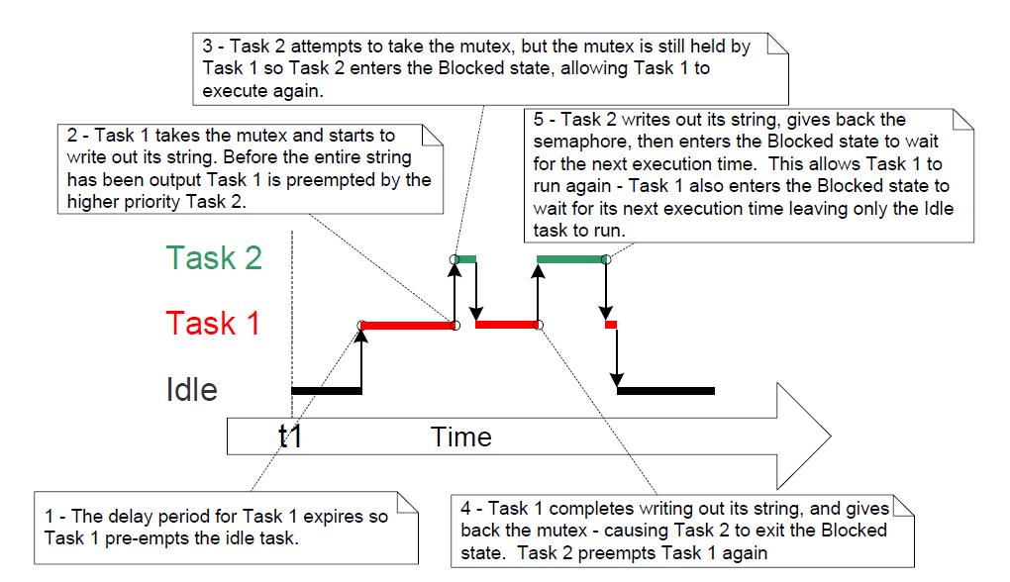
Mutexes

Slide 28
Consequences of Mutex
Priority Inversion
A higher priority task being delayed by a lower priority task in this manner called ‘priority inversion’
This undesirable behavior would be exaggerated further if a medium priority task started to execute while the high priority task was waiting for the semaphore
The result would be a high priority task waiting for a low priority task without the low priority task even being able to execute

Slide 29
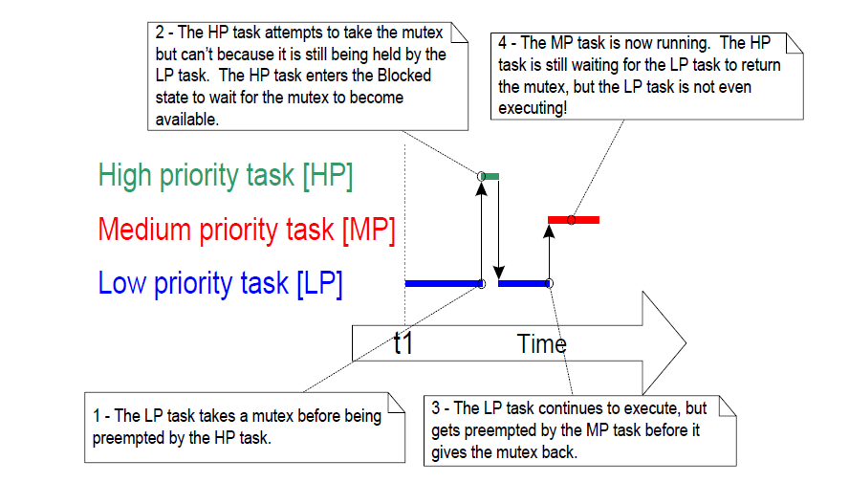
Consequences of Mutex

Slide 30
Consequences of Mutex
Priority Inheritance
Priority inheritance is a scheme that minimizes the negative effects of priority inversion
Priority inheritance works by temporarily raising the priority of the mutex holder to the priority of the highest priority task that is attempting to obtain the same mutex
The low priority task that holds the mutex ‘inherits’ the priority of the task waiting for the mutex

Slide 31
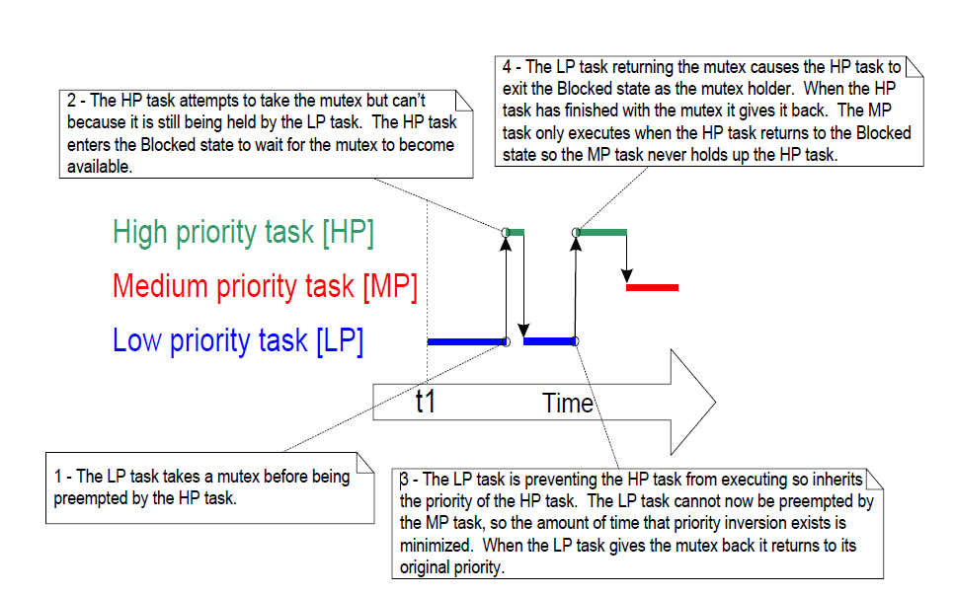
Consequences of Mutex

Slide 32
Consequences of Mutex
Deadlock
Deadlock occurs when two tasks cannot proceed because they are both waiting for a resource that is held by the other
Consider the following scenario where Task A and Task B both need to acquire mutex X and mutex Y in order to perform an action
1. Task A executes and successfully takes mutex X
2. Task A is pre-empted by Task B
3. Task B successfully takes mutex Y before attempting to also take mutex X—but mutex X is held by Task A so is not available to Task B.

Slide 33
Consequences of Mutex
Deadlock
Task B enter the Blocked state to wait for mutex X to be released
4. Task A continues executing. It attempts to take mutex Y—but mutex Y is held by Task B, so is not available to Task A. Task A enter the Blocked state
Now the system is in deadlock
Best method of avoiding deadlock is to consider its potential at design time, and design the system to ensure that deadlock cannot occur

Slide 34
Thank you any questions

