Slide 1
Designing an Image Processing IP
Vipin Kizheppatt

Slide 2
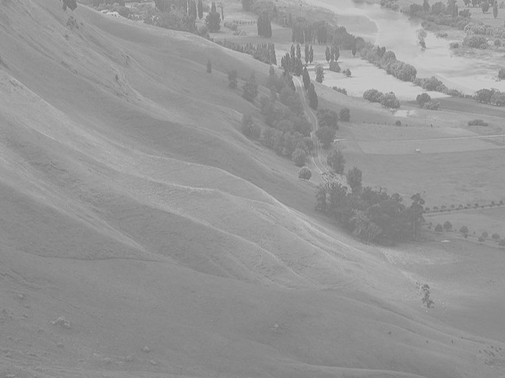
Problem
This image looks washed out

Slide 3
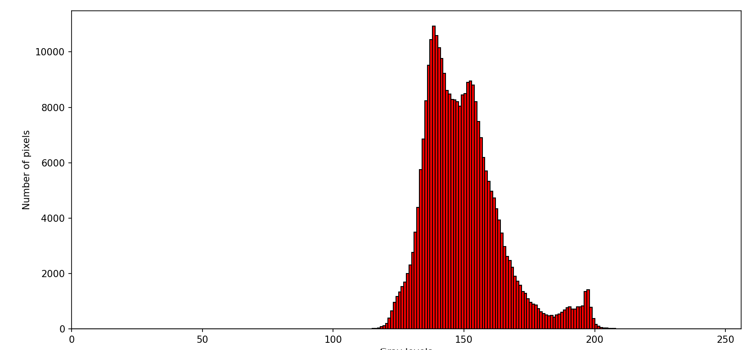
Problem
It is due to lack of ‘contrast’
From the histogram, the range of gray levels are quite limited

Slide 4
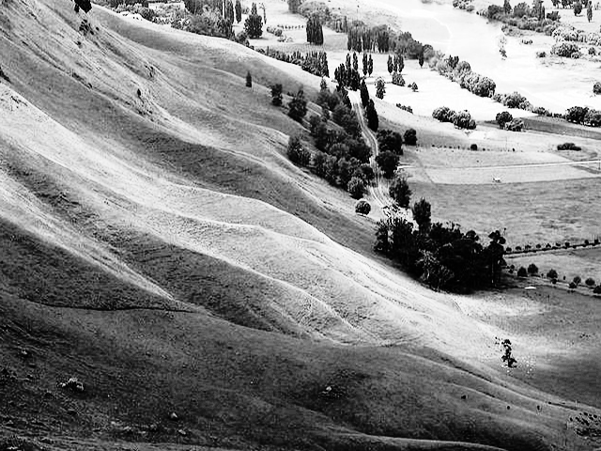
Problem
If we can enhance the contrast (distribute pixels to more gray levels), image might look better

Slide 5
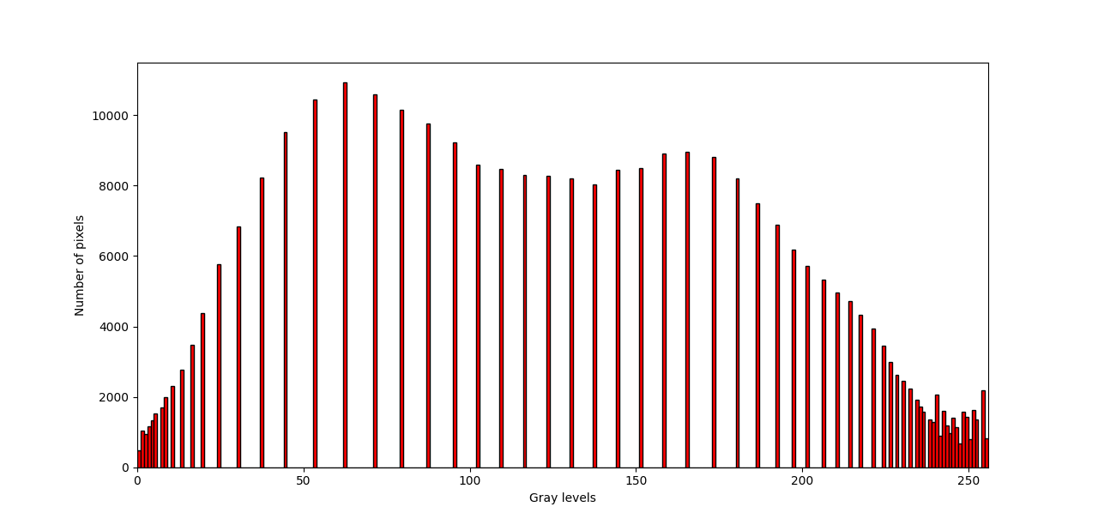
Problem
Now the histogram is more widely distributed
One popular technique used for this purpose is histogram equalization

Slide 6
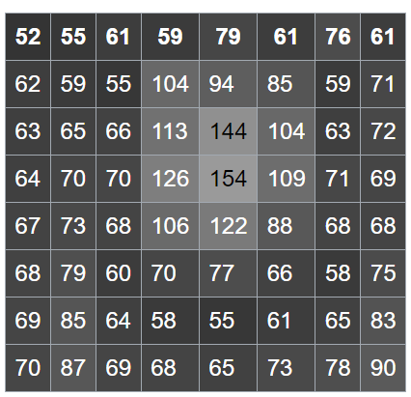

Histogram Equalization (HE)
In HE, a mapping function is used to map a gray level in the input image to another gray level in the output image
For this purpose, the cumulative histogram needs to developed first
Cumulative histogram (CH) for a gray level is the cumulative sum of all the pixels in the image, whose gray level is less than or equal to the gray level that we are considering

Slide 7
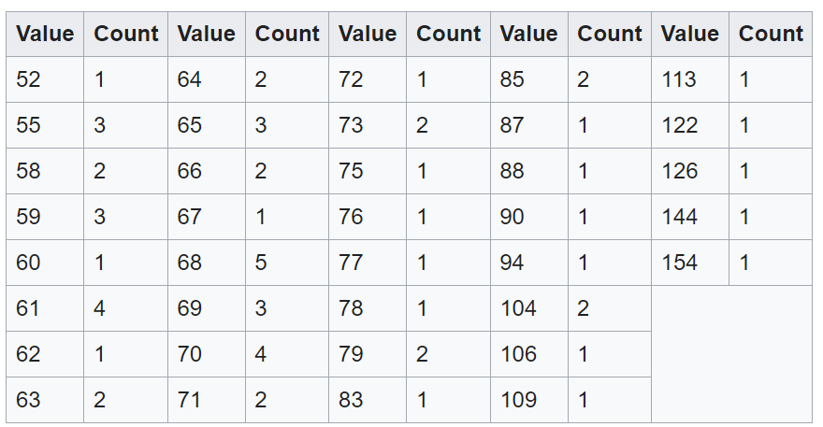
Histogram Equalization (HE)
Value | Count | Value | Count | Value | Count | Value | Count | Value | Count
52 | 1 | 64 | 19 | 72 | 40 | 85 | 51 | 113 | 60
55 | 4 | 65 | 22 | 73 | 42 | 87 | 52 | 122 | 61
58 | 6 | 66 | 24 | 75 | 43 | 88 | 53 | 126 | 62
59 | 9 | 67 | 25 | 76 | 44 | 90 | 54 | 144 | 63
60 | 10 | 68 | 30 | 77 | 45 | 94 | 55 | 154 | 64
61 | 14 | 69 | 33 | 78 | 46 | 104 | 57
62 | 15 | 70 | 37 | 79 | 48 | 106 | 58
63 | 17 | 71 | 39 | 83 | 49 | 109 | 59
Input Image
Histogram
Cumulative Histogram

Slide 8
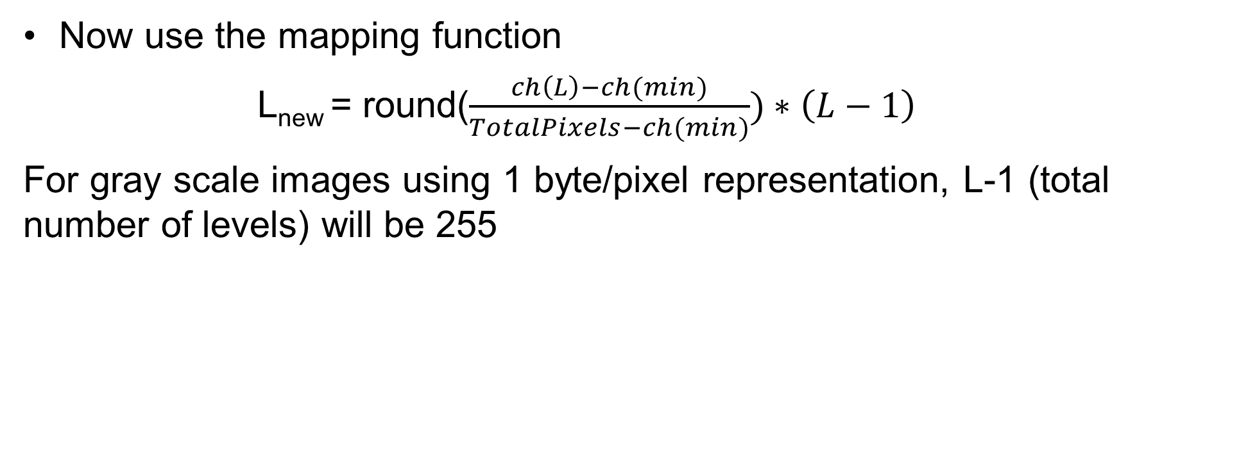
Histogram Equalization (HE)
Now use the mapping function
L_{new} = round($\frac{ch\left(L\right)−ch(min)}{TotalPixels−ch(min)})∗\left(L−1\right)$
For gray scale images using 1 byte/pixel representation, L-1 (total number of levels) will be 255
Value | Lnew | Value | Lnew | Value | Lnew | Value | Lnew | Value | Lnew
52 | 0 | 64 | 73 | 72 | 158 | 85 | 202 | 113 | 239
55 | 12 | 65 | 85 | 73 | 166 | 87 | 206 | 122 | 243
58 | 20 | 66 | 93 | 75 | 170 | 88 | 210 | 126 | 247
59 | 32 | 67 | 97 | 76 | 174 | 90 | 215 | 144 | 251
60 | 36 | 68 | 117 | 77 | 178 | 94 | 219 | 154 | 255
61 | 53 | 69 | 130 | 78 | 182 | 104 | 227
62 | 57 | 70 | 146 | 79 | 190 | 106 | 231
63 | 65 | 71 | 154 | 83 | 194 | 109 | 235

Slide 9
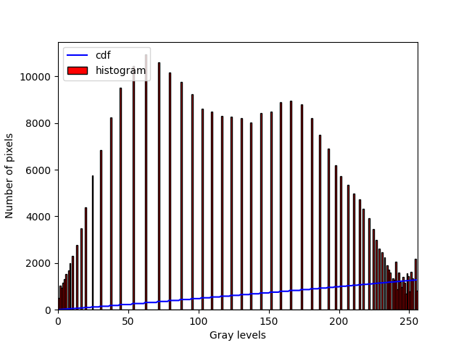
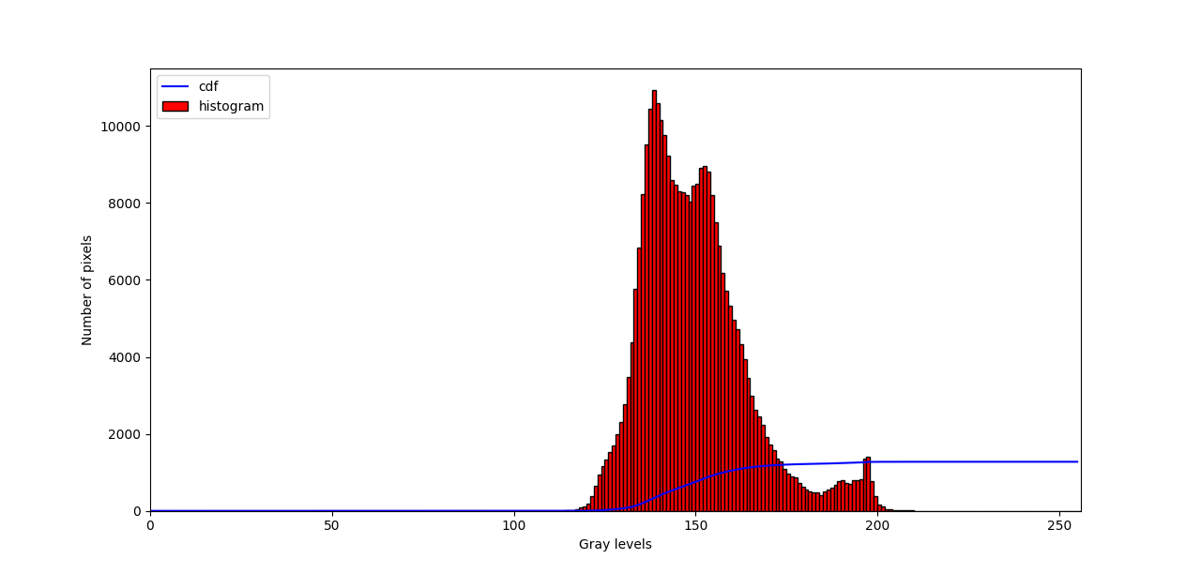
Histogram Equalization (HE)

Slide 10
Hardware Design
Cumulative Histogram Calculator
Gray level
Input pixel
Comparator
Input pixel valid
Counter
Cumulative Histogram
for input gray level

Slide 11
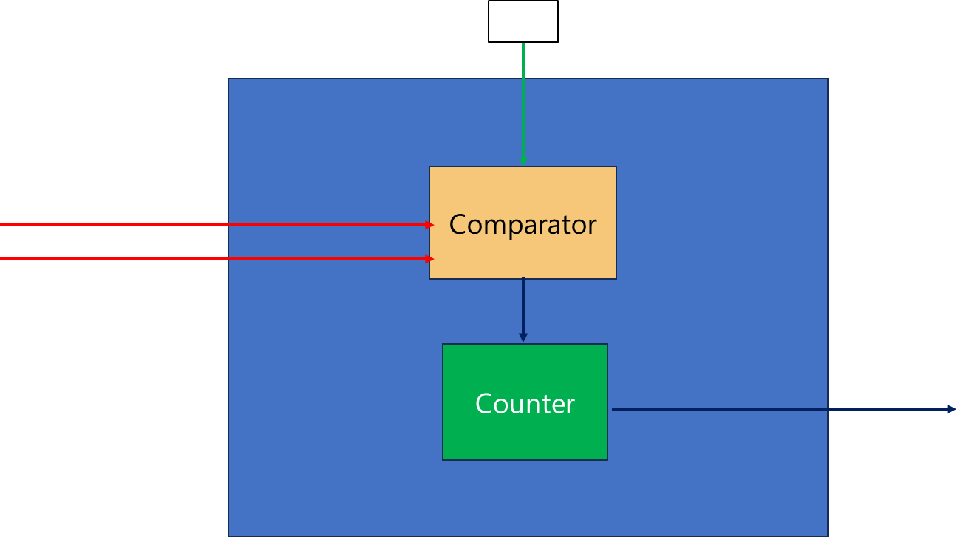
Hardware Design
Cumulative Histogram Calculator
0
Gray 0 CH
1
Gray 1 CH
Input pixel
2
Input pixel valid
Gray 2 CH
255
Gray 255 CH

Slide 12
Hardware Design
Min Cumulative Histogram Calculator
Min Gray level
Input pixel
Comparator
Input pixel valid
Counter
Min Cumulative Histogram

Slide 13
Hardware Design
New Level Calculator
Image Size (total pixels)
CH₀
Sequential New level (L_{new}) Calculation
L_{0(new)}
CH₁
L_{1(new)}
CH₂
L_{2(new)}
CH₂₅₅
L_{255(new)}
CH_{min}

Slide 14
Hardware Design
Mapper
L_{0(new)}
Mux
L_{1(new)}
L_{2(new)}
Pixel Out
L_{255(new)}
Pixel In

Slide 15
Hardware Design
Min calculator
Image Reader
Cumulative Histogram Calculator
New Level Calculator
Mapper
Image Writer
AXI-M
Read
AXI-M
Write
AXIS
AXIS
Control logic
Register File
AXI-Lite i/f

Slide 16
Thank you any questions

