Slide 1
AXI Protocol
Vipin Kizheppatt
16/08/2024

Slide 2
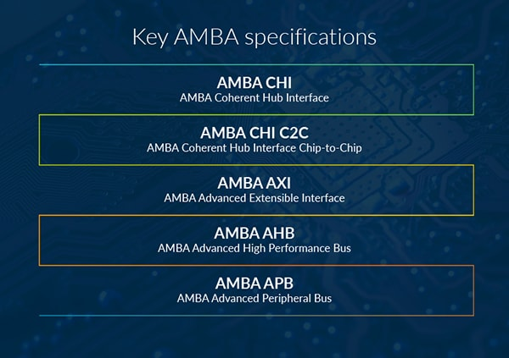
AMBA Specification
Advanced Extensible Interface is part of ARM’s AMBA (Advanced Microcontroller Bus Architecture) specification
AMBA is an on-chip interconnect specification for connection and management of functional blocks in system-on-a-chip (SoC) designs
AMBA provides several benefits such as IP reuse, flexibility and compatibility
Image source: arm.com

Slide 3
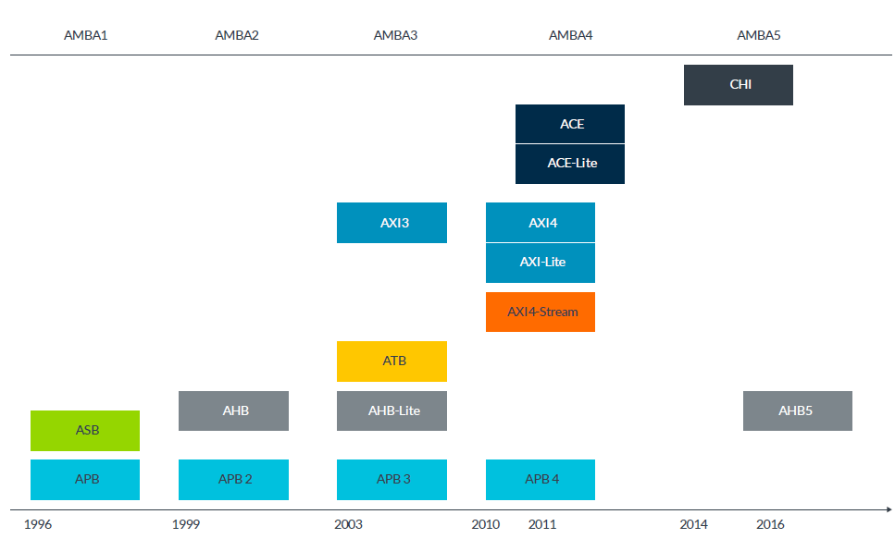
AMBA Evolution

Slide 4
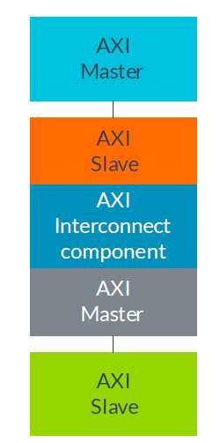
AXI Protocol Overview
AXI is an interface specification that defines the interface of IP blocks
There are only two AXI interface types, master and slave
AXI interconnect interfaces contain the same signals, which makes integration of different IP relatively simple

Slide 5
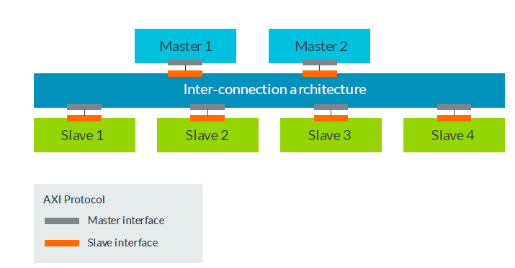
AXI Protocol Overview
An Arm processor is an example of a master, and a simple example of a slave is a memory controller
The AXI protocol defines the signals and timing of the point-to-point connections between masters and slaves
Thus AXI is not a shared bus protocol
When multiple masters and/or slaves are involved, an interconnect fabric is required
AXI in multi-master System

Slide 6
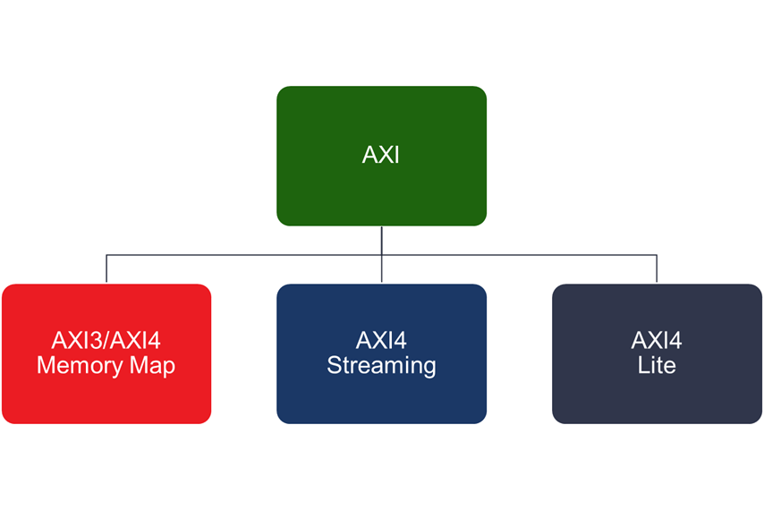
AXI Protocol Overview
There are 3 types of AXI4-Interfaces
AXI4 (Full AXI4): For high performance memory-mapped requirements
AXI4-Lite: For simple, low-throughput memory-mapped communication
AXI4-Stream:For high-speed streaming data

Slide 7
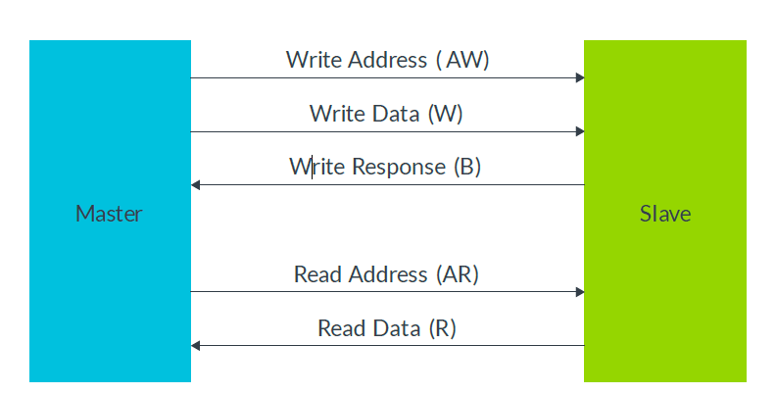
AXI Channels
A channel is an independent collection of AXI signals associated with VALID and READY signals
There are mainly 5 AXI channels (all 5 need not be always present)
During write operations, the master sends an address on the Write Address (AW) channel and transfers data on the Write Data (W) channel to the slave
AXI channels

Slide 8
AXI Channels
Slave writes received data to the specified address. Once the slave has completed the write operation, it responds with a message to the master on the Write Response (B) channel
During read operations the master sends the address it wants to read on the Read Address (AR) channel
Slave sends the data from the requested address to the master on the Read Data (R) channel
AXI channels

Slide 9
AXI Signal Prefixes
AW for signals on the Write Address channel
AR for signals on the Read Address channel
W for signals on the Write Data channel
R for signals on the Read Data channel
B for signals on the Write Response channel
AXI channels

Slide 10
AXI Main features
Independent read and write channels
Multiple outstanding addresses
No strict timing relationship between address and data operations
Support for unaligned data transfers
Out-of-order transaction completion
Burst transactions based on start address

Slide 11
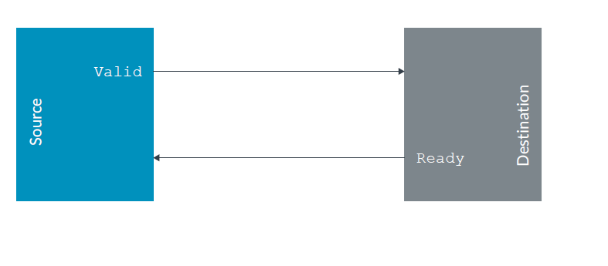
Channel handshake
Each AXI channel has same handshake mechanism that is based on the VALID and READY signals
VALID signal goes from the source to the destination, and READY goes from destination to the source
Source uses VALID signal to indicate when valid information is available
VALID signal must remain asserted until destination accepts the information

Slide 12
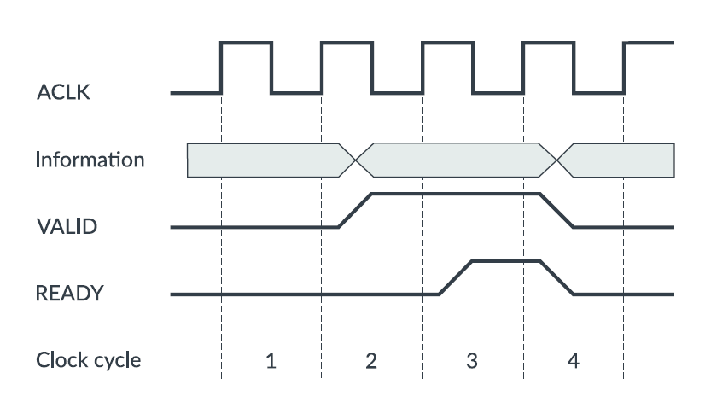
Channel handshake
Destination indicates when it can accept information using the READY signal
The handshaking happens on rising edge of clock signal
Data transfer happens

Slide 13
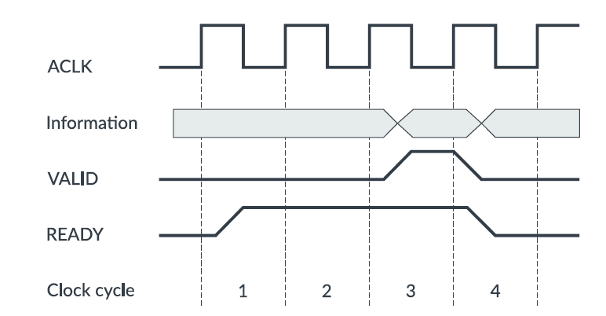
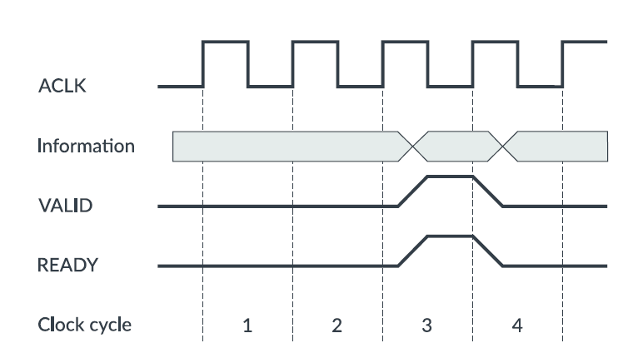
Channel handshake
Data transfer happens
Data transfer happens

Slide 14
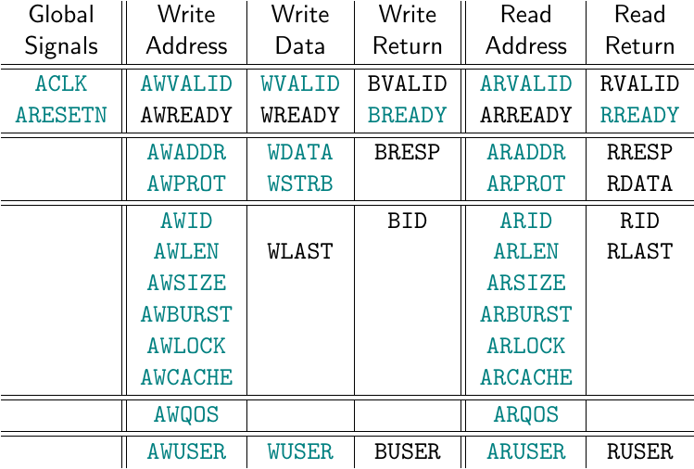
AXI Signals

Slide 15
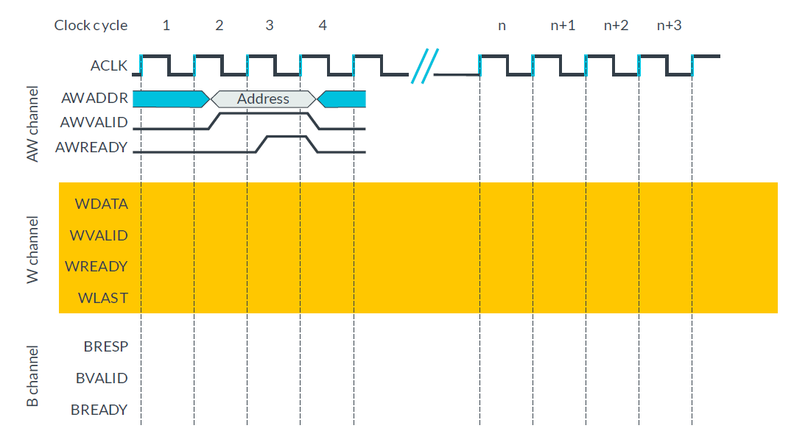
AXI Write transaction (Single data)

Slide 16
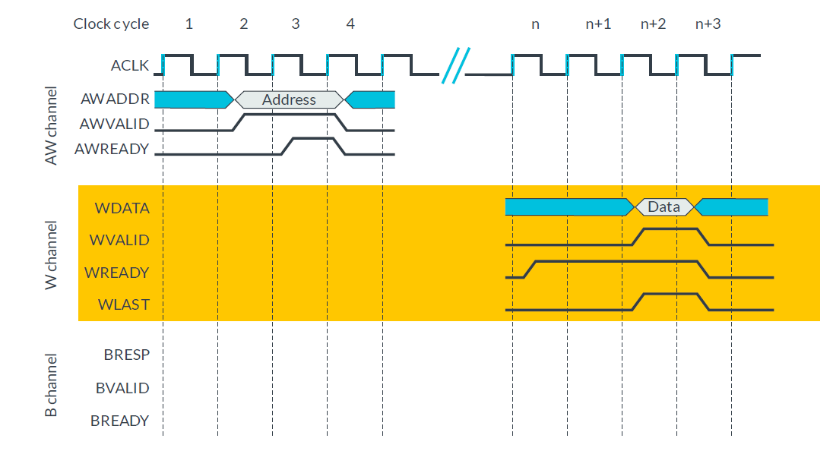
AXI Write transaction (Single data)

Slide 17
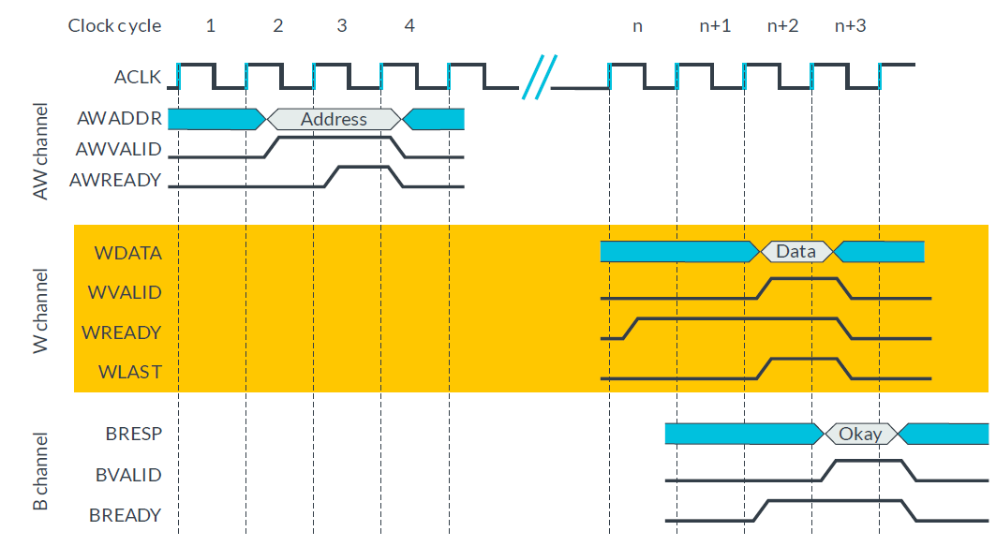
AXI Write transaction (Single data)

Slide 18
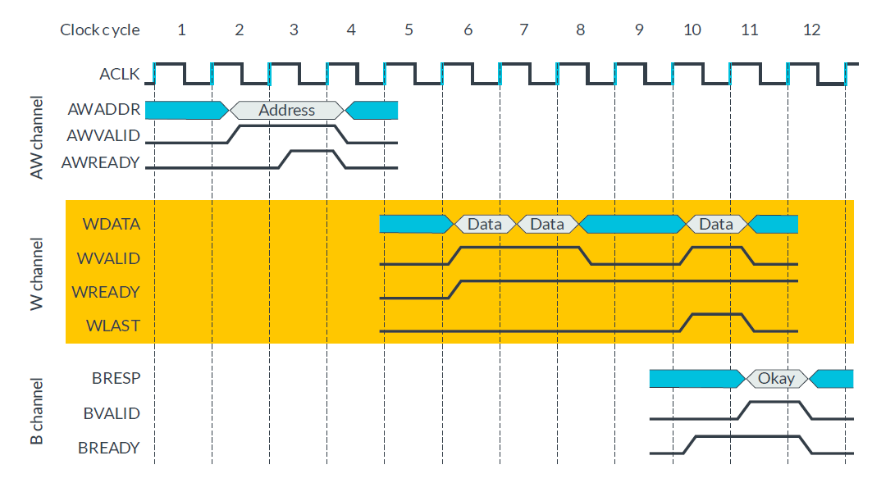
AXI Write transaction (Multiple data)

Slide 19
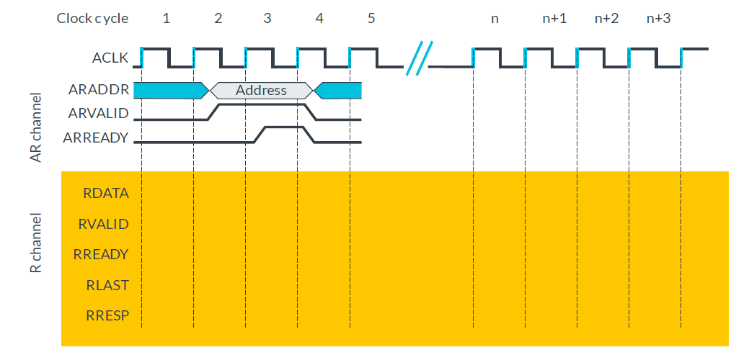
AXI Read transaction (Single data)

Slide 20
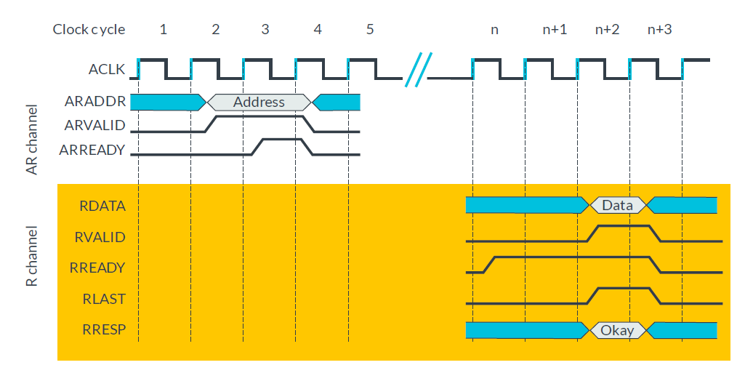
AXI Read transaction (Single data)

Slide 21
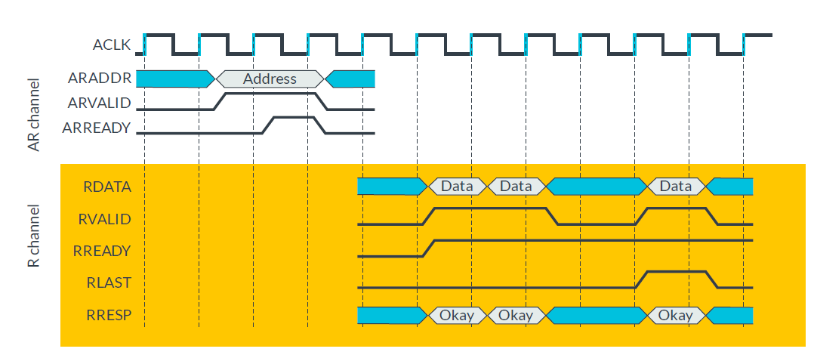
AXI Read transaction (Multiple data)

Slide 22
Thank you any questions

