Slide 1
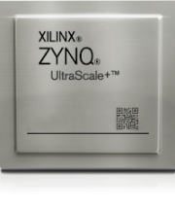
Xilinx Zynq Platform
Vipin Kizheppatt
Materials in this presentation are from Xilinx/AMD and all the copy rights belong to the original author
07/08/2024

Slide 2
Zynq Architecture
Zynq
14.2 Version

Slide 3
Objectives
After completing this module, you will be able to:
  Identify the basic building blocks of the Zynq™ architecture processing system (PS)
  Describe the usage of the Cortex-A9 processor memory space
  Connect the PS to the programmable logic (PL) through the AXI ports
  Generate clocking sources for the PL peripherals
  List the various AXI-based system architectural models
  Name the five AXI channels
  Describe the operation of the AXI streaming protocol

Slide 4
Outline
Zynq All Programmable SoC (AP SoC)
Zynq AP SoC Processing System (PS)
Processor Peripherals
Clock, Reset, and Debug Features
AXI Interfaces
Summary

Slide 5
Zynq-7000 Family Highlights
Complete ARM®-based processing system
  Application Processor Unit (APU)
    Dual ARM Cortex™-A9 processors
    Caches and support blocks
  Fully integrated memory controllers
  I/O peripherals
Tightly integrated programmable logic
  Used to extend the processing system
  Scalable density and performance
Flexible array of I/O
  Wide range of external multi-standard I/O
  High-performance integrated serial transceivers
  Analog-to-digital converter inputs

Slide 6
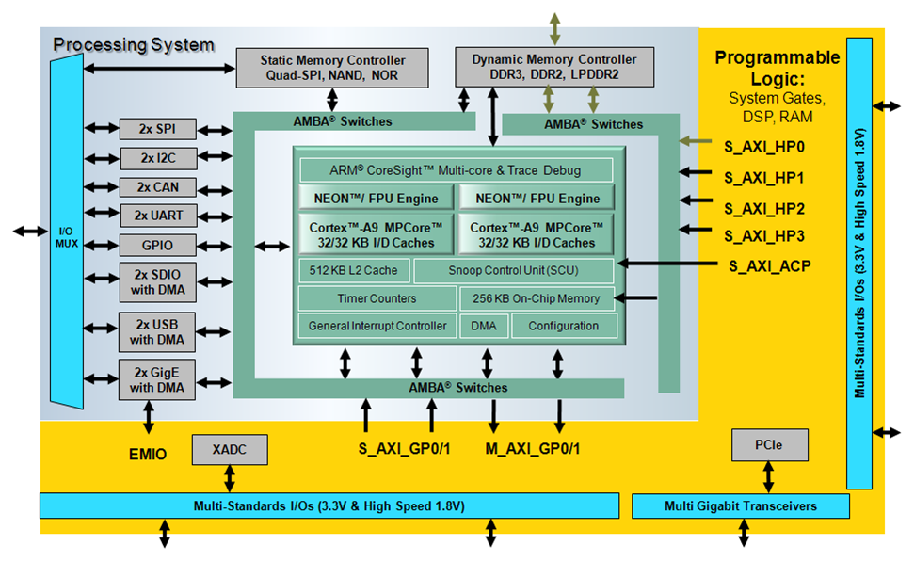
Zynq-7000 AP SoC Block Diagram

Slide 7
The PS and the PL
The Zynq-7000 AP SoC architecture consists of two major sections
  PS: Processing system
    Dual ARM Cortex-A9 processor based
    Multiple peripherals
    Hard silicon core
  PL: Programmable logic
    Shares the same 7 series programmable logic as
      Artix™-based devices: Z-7010 and Z-7020 (high-range I/O banks only)
      Kintex™-based devices: Z-7030 and Z-7045 (mix of high-range and high-performance I/O banks)

Slide 8
ARM Processor Architecture
ARM Cortex-A9 processor implements the ARMv7-A architecture
  ARMv7 is the ARM Instruction Set Architecture (ISA)
  ARMv7-A: Application set that includes support for a Memory Management Unit (MMU)
  ARMv7-R: Real-time set that includes support for a Memory Protection Unit (MPU)
  ARMv7-M: Microcontroller set that is the smallest set
The ARMv7 ISA includes the following types of instructions (for backwards compatibility)
  Thumb instructions: 16 bits; Thumb-2 instructions: 32 bits
  NEON: ARM’s Single Instruction Multiple Data (SIMD) instructions
ARM Advanced Microcontroller Bus Architecture (AMBA®) protocol
  AXI3: Third-generation ARM interface
  AXI4: Adding to the existing AXI definition (extended bursts, subsets)
Cortex is the new family of processors
  ARM family is older generation; Cortex is current; MMUs in Cortex processors and MPUs in ARM

Slide 9
ARM Cortex-A9 Processor Power
Dual-core processor cluster
2.5 DMIP/MHz per processor
Harvard architecture
Self-contained 32KB L1 caches for instructions and data
External memory based 512KB L2 cache
Automatic cache coherency between processor cores
800-MHz operation (fastest speed grade)

Slide 10
Outline
Zynq All Programmable SoC (AP SoC)
Zynq AP SoC Processing System (PS)
Processor Peripherals
Clock, Reset, and Debug Features
AXI Interfaces
Summary

Slide 11
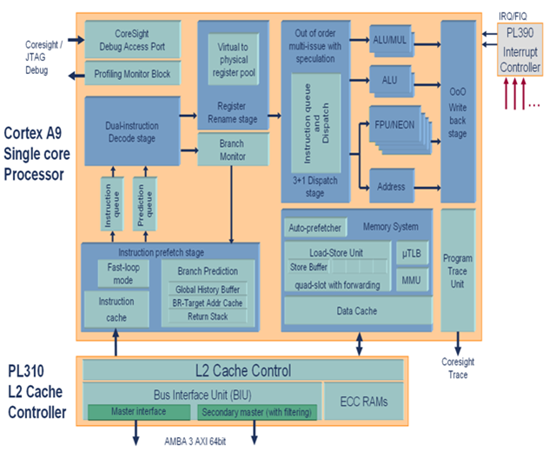
ARM Cortex-A9 Processor Micro-Architecture
Instruction pipeline supports out-of-order instruction issue and completion
Register renaming to enable execution speculation
Non-blocking memory system with load-store forwarding
Fast loop mode in instruction pre-fetch to lower power consumption

Slide 12
ARM Cortex-A9 Processor Micro-Architecture
Variable length, out-of-order, eight-stage, super-scalar instruction pipeline
  Advanced pre-fetch with parallel branch pipeline enabling early branch prediction and resolution
  Multi-issued into
    Primary data processing pipeline
    Secondary full data processing pipeline
    Load-store pipeline
    Compute engine (FPU/NEON) pipeline
Speculative execution
  Supports virtual renaming of ARM physical registers to remove pipeline stalls due to data dependencies
  Increased processor utilization and hiding of memory latencies
  Increased performance by hardware unrolling of code loops
  Reduced interrupt latency via speculative entry to Interrupt Service Routine (ISR)

Slide 13
PS Components
Application processing unit (APU)
I/O peripherals (IOP)
  Multiplexed I/O (MIO), extended multiplexed I/O (EMIO)
Memory interfaces
PS interconnect
DMA
Timers
  Public and private
General interrupt controller (GIC)
On-chip memory (OCM): RAM
Debug controller: CoreSight

Slide 14
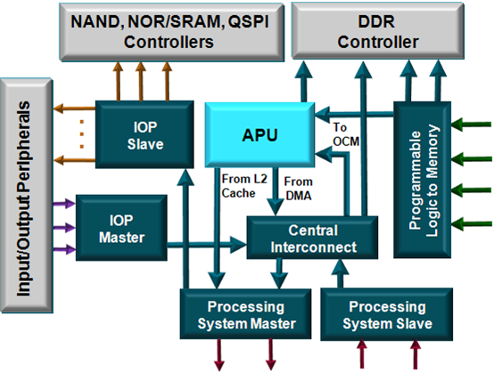
Processing System Interconnect (1)
Programmable logic to memory
  Two ports to DDR
  One port to OCM SRAM
Central interconnect
  Enables other interconnects to communicate
Peripheral master
  USB, GigE, SDIO connects to DDR and PL via the central interconnect
Peripheral slave
  CPU, DMA, and PL access to IOP peripherals

Slide 15
Processing System Interconnect (2)
Processing system master
  Two ports from the processing system to programmable logic
  Connects the CPU block to common peripherals through the central interconnect
Processing system slave
  Two ports from programmable logic to the processing system

Slide 16
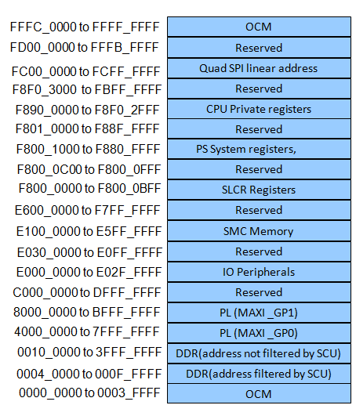
Memory Map
The Cortex-A9 processor uses 32-bit addressing
All PS peripherals and PL peripherals are memory
mapped to the Cortex-A9 processor cores
All slave PL peripherals will be located between
4000_0000 and 7FFF_FFFF (connected to GP0) and
8000_0000 and BFFF_FFFF (connected to GP1)

Slide 17
Zynq AP SoC Memory Resources
On-chip memory (OCM)
  RAM
  Boot ROM
DDRx dynamic memory controller
  Supports LPDDR2, DDR2, DDR3
Flash/static, memory controller
  Supports SRAM, QSPI, NAND/NOR FLASH

Slide 18
PS Boots First
CPU0 boots from OCM ROM; CPU1 goes into a sleep state
On-chip boot loader in OCM ROM (Stage 0 boot)
Processor loads First Stage Boot Loader (FSBL) from external flash memory
  NOR
  NAND
  Quad-SPI
  SD Card
  JTAG; not a memory device—used for development/debug only
  Boot source selected via package bootstrapping pins
Optional secure boot mode allows the loading of encrypted software from the flash boot memory

Slide 19
Configuring the PL
The programmable logic is configured after the PS boots
Performed by application software accessing the hardware device configuration unit
  Bitstream image transferred
  100-MHz, 32-bit PCAP stream interface
  Decryption/authentication hardware option for encrypted bitstreams
    In secure boot mode, this option can be used for software memory load
  Built-in DMA allows simultaneous PL configuration and OS memory loading

Slide 20
Outline
Zynq All Programmable SoC (AP SoC)
Zynq AP SoC Processing System (PS)
Processor Peripherals
Clock, Reset, and Debug Features
AXI Interfaces
Summary

Slide 21
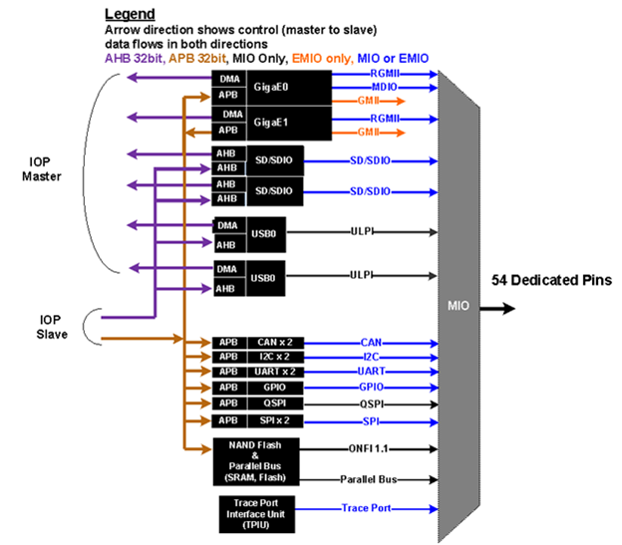
Input/Output Peripherals
Two GigE
Two USB
Two SPI
Two SD/SDIO
Two CAN
Two I2C
Two UART
Four 32-bit GPIOs
Static memories
  NAND, NOR/SRAM, Quad SPI
Trace ports

Slide 22
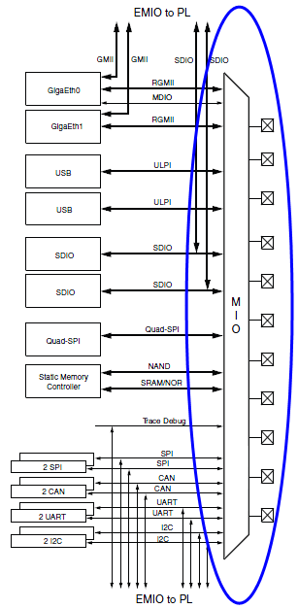
Multiplexed I/O (MIO)
External interface to PS I/O peripheral ports
  54 dedicated package pins available
  Software configurable
    Automatically added to bootloader by tools
  Not available for all peripheral ports
    Some ports can only use EMIO

Slide 23
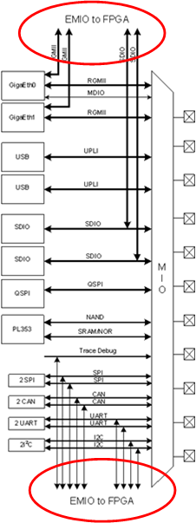
Extended Multiplexed I/O (EMIO)
Extended interface to PS I/O peripheral ports
  EMIO: Peripheral port to programmable logic
  Alternative to using MIO
  Mandatory for some peripheral ports
  Facilitates
    Connection to peripheral in programmable logic
    Use of general I/O pins to supplement MIO pin usage
    Alleviates competition for MIO pin usage

Slide 24
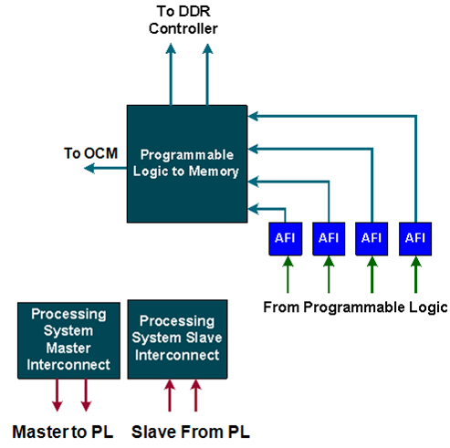
PS-PL Interfaces
AXI high-performance slave ports (HP0-HP3)
  Configurable 32-bit or 64-bit data width
  Access to OCM and DDR only
  Conversion to processing system clock domain
  AXI FIFO Interface (AFI) are FIFOs (1KB) to smooth
  large data transfers
AXI general-purpose ports (GP0-GP1)
  Two masters from PS to PL
  Two slaves from PL to PS
  32-bit data width
  Conversation and sync to processing system
  clock domain

Slide 25
PS-PL Interfaces
One 64-bit accelerator coherence port (ACP) AXI slave interface to CPU memory
DMA, interrupts, events signals
  Processor event bus for signaling event information to the CPU
  PL peripheral IP interrupts to the PS general interrupt controller (GIC)
  Four DMA channel RDY/ACK signals
Extended multiplexed I/O (EMIO) allows PS peripheral ports access to PL logic and device I/O pins
Clock and resets
  Four PS clock outputs to the PL with enable control
  Four PS reset outputs to the PL
Configuration and miscellaneous

Slide 26
Outline
Zynq All Programmable SoC (AP SoC)
Zynq AP SoC Processing System (PS)
Processor Peripherals
Clock, Reset, and Debug Features
AXI Interfaces
Summary

Slide 27
PL Clocking Sources
PS clocks
  PS clock source from external package pin
  PS has three PLLs for clock generation
  PS has four clock ports to PL
The PL has 7 series clocking resources
  PL has a different clock source domain compared to the PS
  The clock to PL can be sourced from external clock capable pins
  Can use one of the four PS clocks as source
Synchronizing the clock between PL and PS is taken care of by the architecture of the PS
PL cannot supply clock source to PS

Slide 28
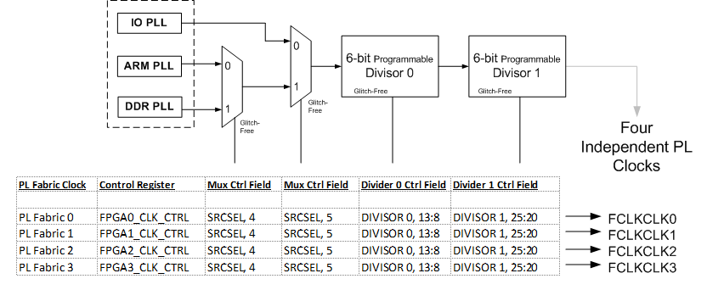
Clocking the PL

Slide 29
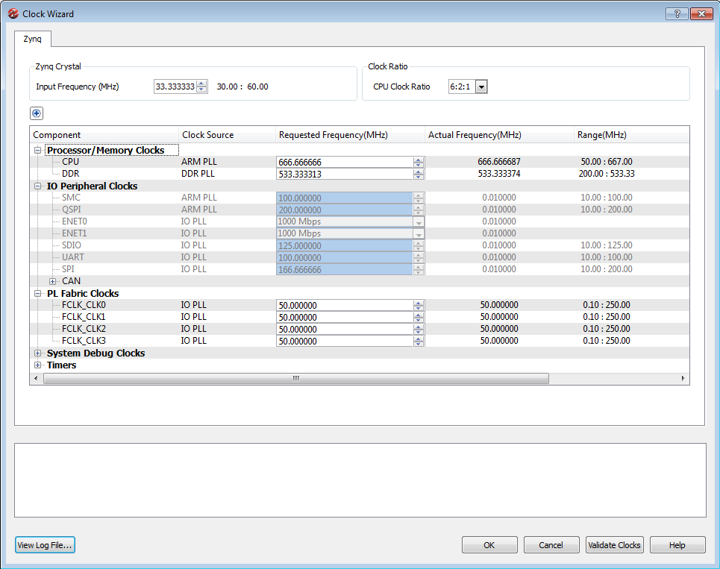
Clock Generation (Using Zynq Tab)
The Clock Generator allows the configuration of PLL components for both the PS and PL of the Zynq AP SoC
  One input reference clock
Access the GUI by clicking the Clock Generation block in the Zynq tab of the SAV
Configure the PS Peripheral Clock in the Zynq tab
  PS uses a dedicated PLL clock
  PS I/O peripherals use the I/O PLL clock and ARM PLL
Clock to PL is disabled if PS clocking is present

Slide 30
Zynq Resets
Internal resets
  Power-on reset (POR)
  Watchdog resets from the three watchdog timers
  Secure violation reset
PS resets
  External reset: PS_SRST_B
  Warm reset: SRSTB
PL resets
  Four reset outputs from PS to PL
  FCLK_RESET[3:0]

Slide 31
Outline
Zynq All Programmable SoC (AP SoC)
Zynq AP SoC Processing System (PS)
Processor Peripherals
Clock, Reset, and Debug Features
AXI Interfaces
Summary

Slide 32

AXI is Part of ARM’s AMBA
APB
AHB
AXI
AMBA
AMBA 3.0
(2003)
Older Performance Newer
AMBA: Advanced Microcontroller Bus Architecture
AXI: Advanced Extensible Interface
Notes:
AMBA is a family of interfaces used by ARM for all of its processors. Every ARM chip that ships (and there’s a lot of them. ARM microprocessors are used in iPods, Cell Phones, GPS receivers, etc), has IP that sits on at least one of these interfaces.
AMBA currently has 3 main interfaces families; APB, which was introduced in AMBA1; AHB, which was added in AMBA2; and AXI, which was added in AMBA3. Each offered successively higher performance.
AMBA3 is currently the most broadly adopted version of AMBA, though AMBA4 just came out, as we’ll see.

Slide 33
AXI is Part of AMBA
AMBA
APB
AHB
AXI
AXI-4
Memory Map
AXI-4
Stream
AXI-4
Lite
ATB
Enhancements for FPGAs
AMBA 3.0
(2003)
Same Spec
AMBA 4.0
(2010)
Interface | Features | Similar to
Memory Map / Full (AXI4) | Traditional Address/Data Burst (single address, multiple data) | PLBv46, PCI
Streaming (AXI4-Stream) | Data-Only, Burst | Local Link / DSP Interfaces / FIFO / FSL
Lite (AXI4-Lite) | Traditional Address/Data—No Burst (single address, single data) | PLBv46-single OPB

Slide 34
Basic AXI Signaling – 5 Channels
Read Address Channel
Read Data Channel
Write Address Channel
Write Data Channel
Write Response Channel
Notes:
AXI, at the highest level consists of the 5 channels shown.
Each channel is independent. And as you’ll see, whether its AXI4, AXI4-Lite or AXI4-Stream, the interfaces are effectively the same.

Slide 35
The AXI Interface—AX4-Lite
No burst
Data width 32 or 64 only
  Xilinx IP only supports 32-bits
Very small footprint
Bridging to AXI4 handled
automatically by
AXI_Interconnect (if needed)
AXI4-Lite Read
AXI4-Lite Write
Notes:
AXI4-Lite is similar to AXI4 but only burst a signal data beat. There are some other features as well that allow this to be a very small footprint interface.

Slide 36
The AXI Interface—AXI4
Sometimes called “Full AXI” or “AXI Memory Mapped”
  Not ARM-sanctioned names
Single address multiple data
  Burst up to 256 data beats
Data Width parameterizable
  1024 bits
AXI4 Read
AXI4 Write
Notes:
Whether you’re doing a read or write, an AXI4 transaction is the same. An address comes out, then the data is either written by the master or provided by the slave. The extra channel, Write Response, allows the slave to tell the master, in a write transaction, status on the transaction.
AXI4 can burst up to 256 data beats, the bit width of the Data depends on the design.

Slide 37
The AXI Interface—AXI4-Stream
No address channel, no read and write, always just master to slave
  Effectively an AXI4 “write data” channel
Unlimited burst length
  AXI4 max 256
  AXI4-Lite does not burst
Virtually same signaling as AXI Data Channels
  Protocol allows merging, packing, width conversion
  Supports sparse, continuous, aligned, unaligned streams
AXI4-Stream Transfer
Notes:
AXI4-Stream is somewhat different from AXI4 and AXI4-Lite. It is much like a single “Write Data” channel. In addition, there is no limit to the size of the burst on an AXI4-Stream channel.

Slide 38
Streaming Applications
May not have packets
  E.g. Digital up converter
    No concept of address
    Free-running data (in this case)
    In this situation, AXI4-Stream would optimize to a very simple interface
May have packets
  E.g. PCIe
    Their packets may contain different information
    Typically bridge logic of some sort is needed

Slide 39
Outline
Zynq All Programmable SoC (AP SoC)
Zynq AP SoC Processing System (PS)
Processor Peripherals
Clock, Reset, and Debug Features
AXI Interfaces
Summary

Slide 40
Summary
The Zynq-7000 processing platform is a system on a chip (SoC) processor with embedded programmable logic
The processing system (PS) is the hard silicon dual core consisting of
  APU and list components
    Two Cortex-A9 processors
    NEON co-processor
    General interrupt controller (GIC)
    General and watchdog timers
  I/O peripherals
  External memory interfaces

Slide 41
Summary
The programmable logic (PL) consists of 7 series devices
AXI is an interface providing high performance through point-to-point connection
AXI has separate, independent read and write interfaces implemented with channels
The AXI4 interface offers improvements over AXI3 and defines
  Full AXI memory mapped
  AXI Lite
  AXI Stream
Tightly coupled AXI ports interface the PL and PS for maximum performance
The PS boots from a selection of external memory devices
The PL is configured by and after the PS boots
The PS provides clocking resources to the PL
The PL may not provide clocking to the PS

Slide 42
Thank you any questions

