Slide 1
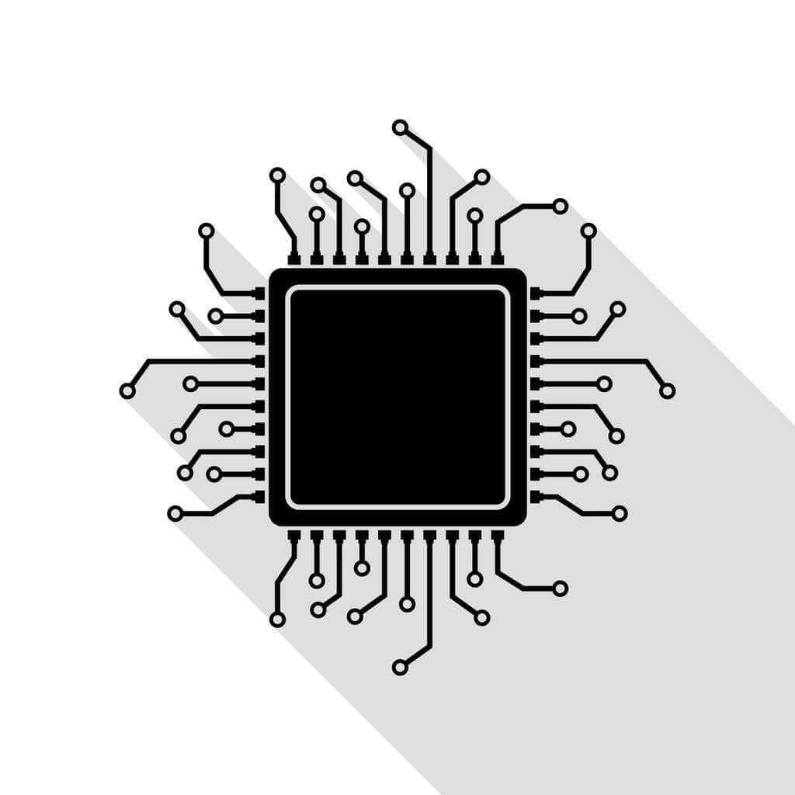
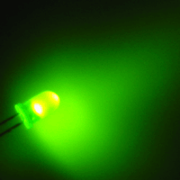
The Blinking LED
Vipin Kizheppatt
05/08/2024

Slide 2
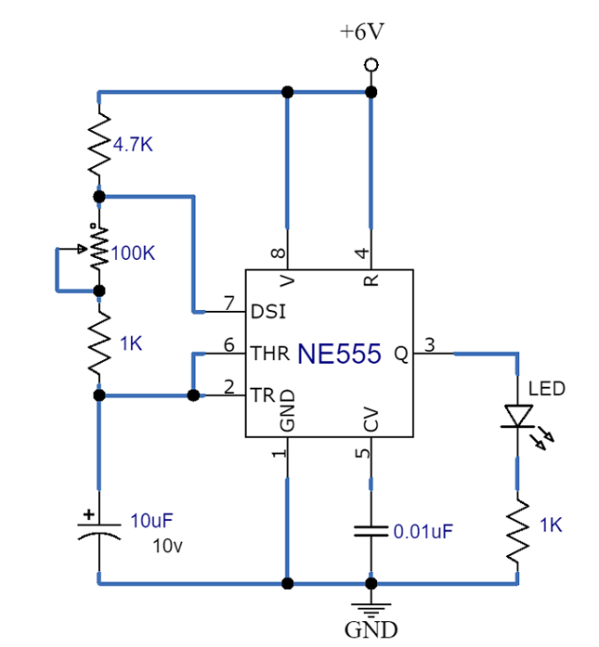
Objective
Design a system to blink an LED
  The blink delay shall be configurable
Hardware Implementation

Slide 3
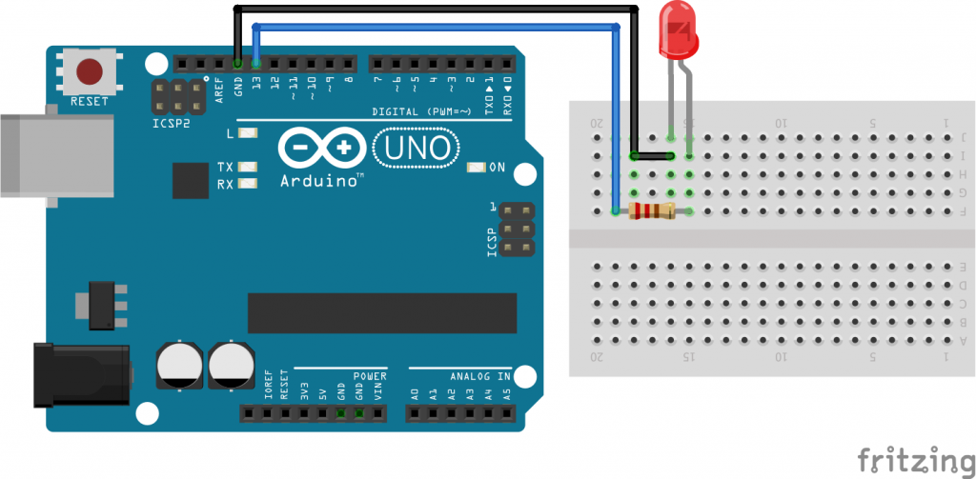
Objective
Design a system to blink an LED
  The blink delay shall be configurable
  The resolution and precision required in the delay is in order of 10 ns !!
void setup() {
// initialize digital pin 13 as an output.
pinMode(13, OUTPUT);
}
// the loop function runs over and over again forever
void loop() {
digitalWrite(13, HIGH); // turn the LED on
delay(1000); // wait for a second
digitalWrite(13, LOW); // turn the LED off
delay(1000); // wait for a second
}
Software Implementation

Slide 4


Objective
Design a system to blink an LED
  The blink delay shall be configurable
  The resolution and precision required in the delay is in order of 10 ns !!
  Software delay generators will not be able to provide such low resolution with such precision
  This will require a custom hardware
  Easiest way is to use a counter to count clock cycles to generate required delay and toggle the LED
Clock
Required Delay Reg
Counter
Comparator

Slide 5
Hardware Design
Our current design is still pure hardware in nature
To modify the delay somehow the contents of Required Delay Reg need to change
The value to be stored in the register also needs to be calculated
So we need to look at system specification
Since the resolution required is 10ns, the clock period needs to be at least 10ns (or factors of 10)
We will design using 10ns clock (100MHz clock freq.)
Clock
Required Delay Reg
Counter
Comparator

Slide 6
Hardware Design
The range of delay required is 100 ns to 2 Secs at resolution of 10ns
Delay value corresponding to 2 Sec is 2/10ns = 20,00,00,000
In binary 28-bits are required to store 20,00,00,000
A great advantage of custom hardware is arbitrary bit width
Thus the size of Counter and Delay Reg are 28-bits
Comparator output is only 1 bit since we are driving a single LED
Clock (100 MHz)
Clock
Required Delay Reg
28
Counter
28
Comparator

Slide 7
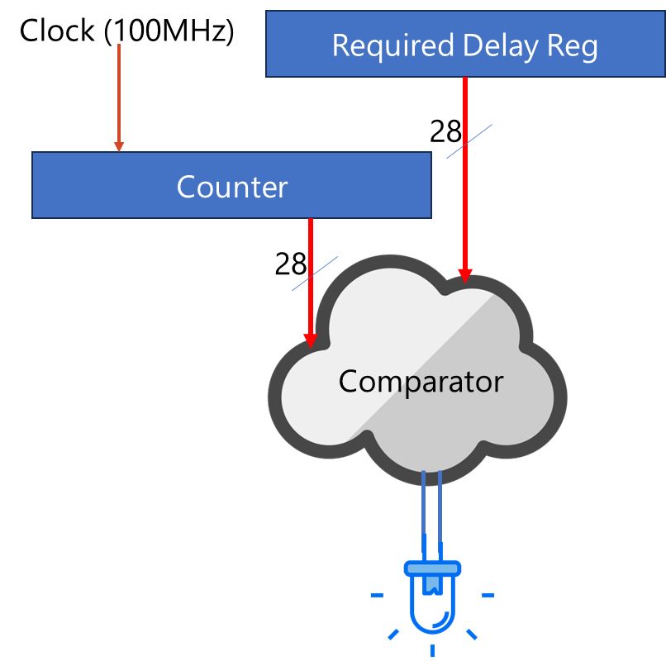
Hardware Design
module ledBlink(
input clk,
input [27:0] requiredDelay,
output reg led
);
reg [27:0] counter;
initial
begin
counter <= 0;
led <= 0;
end
always @(posedge clk)
begin
if(counter != requiredDelay-1)
counter <= counter+1;
else
counter <= 0;
end
always @(posedge clk)
begin
if(counter == requiredDelay-1)
led <= ~led;
end
endmodule

Slide 8
Hardware Design
module ledBlink(
input clk,
input [27:0] requiredDelay,
output reg led
);
reg [27:0] counter;
initial
begin
counter <= 0;
led <= 0;
end
always @(posedge clk)
begin
if(counter != requiredDelay-1)
counter <= counter+1;
else
counter <= 0;
end
always @(posedge clk)
begin
if(counter == requiredDelay-1)
led <= ~led;
end
endmodule

Slide 9
Hardware Design
Although we can use 28 switches to configure the Required Delay a practical and a more viable solution will be to interface this hardware with a processor do this under software control
Since processors need to communicate with a variety of peripherals, they use some kind of standard bus interfaces for communicating with peripherals

Slide 10
Hardware Design
Processor
Although we can use 28 switches to configure the Required Delay a practical and a more viable solution will be to interface this hardware with a processor do this under software control
Since processors need to communicate with a variety of peripherals, they use some kind of standard bus interfaces for communicating with peripherals
The bus interface usually have signals carrying address (address bus), data (data bus) and control signals (control bus)
Address
Data
Control

Slide 11
Hardware Design
Processor
Our current custom LED hardware is not compatible with the processor interface
This necessitates including a wrapper with a compatible bus interface logic
Our custom LED blinker is an independent design unit now and can be considered as an intellectual property (IP)
Address
Data
Control
Bus interface (slave)
LED Blink IP

Slide 12
Software Design
Processor
We use software to control the delay of blinking
The first question to address is how are we going to access the IP from software
Each processor will have some instruction to place address and data on the address bus
By giving different addresses to different peripherals, each of them can be accessed individually
Usually there are two addressing modes supported by processors : IO mapped and memory mapped
IP 1
Address
0x1000-0x2000
Address
Control
Data
IP 2
Address
0x2000-0x4000
IP 3
Address
0x4000-0x6000

Slide 13
Software Design
Processor
Throughout this course we will be using memory-mapped IO
This means at instruction level, processor uses same instruction to access memory (RAM) and peripheral
Thus from processor perspective it does not distinguish between actual memory and other peripherals and treats all peripherals like memory
There should address decoder(s) in the system so that only the peripheral addressed by processor is enabled during a transaction
IP 1
Address
0x1000-0x2000
De
code
r
En
Address
Control
Data
IP 2
Address
0x2000-0x4000
En
IP 3
Address
0x4000-0x6000
En

Slide 14
Software Design
#include “blink.h”
// Function to configure the LED IP
// Arguments
// delay : blinking delay in ns
// Return
// 0 on success, -1 on fail
int blink(int delay) {
int delayVal;
int *IPAddr;
delayVal = delay/ClockPeriod;
if(delayVal > MaxDelay)
return -1;
IPAddr = 0x1000; //Assume IP address is 0x1000
*IPAddr = delayVal;
return 0;
}
When we develop software, we follow the principle of abstraction
We expose only the necessary details and hide all implementation details
In our example, calculation of value to be loaded to Delay Register can be abstracted
Functionality of IP is exposed through a few functions called Application Programming Interface (API)
We design separate library for each IP to enable code reuse
blink.c
#define ClockPeriod 10 // 10ns clock delay
#define MaxDelay 200000000
int blink(int delay);
blink.h
#include “blink.h”
int main(){
blink(1000000); //blink with 1 sec delay
}
main.c

Slide 15
Software Design
#define IP1_BaseAddr 0x1000
#define IP2_BaseAddr 0x2000
#define IP2_BaseAddr 0x4000
Previous code can be improved by removing hard-coded address of IP in the blink function
In most cases only hardware information needed by software developer is address mapping
When there are multiple registers in the IP, software developer needs to know their addresses and functionalities (our blink IP has a single register)
addressMap.h
#define ClockPeriod 10 // 10ns clock delay
#define MaxDelay 200000000
typedef struct blinkIP{
int BaseAddr;
}blinkIP;
int initBlink(blinkIP *inst, int BaseAddr);
int blink(blinkIP *inst, int delay);
blink.h

Slide 16
Software Design
Keep minimum dependencies between
modules.
#include “blink.h”
int initBlink(blinkIP *inst, int BaseAddr){
inst->BaseAddr = BaseAddr;
return 0;
}
int blink(blinkIP *inst, int delay) {
int delayVal;
delayVal = delay/ClockPeriod;
if(delayVal > MaxDelay)
return -1;
*(int*)(inst->BaseAddr) = delayVal;
return 0;
}
This is 32-bits, but in hardware we have
only 28-bits
blink.c
Review pointers and type casting
#include “addressMap.h”
#include “blink.h”
int main(){
blinkIP myBlink;
initBlink(&myBlink,IP1_BaseAddr);
blink(&myBlink,1000000); //blink with 1 sec delay
}
main.c

Slide 17
Thank you any questions

