Slide 1
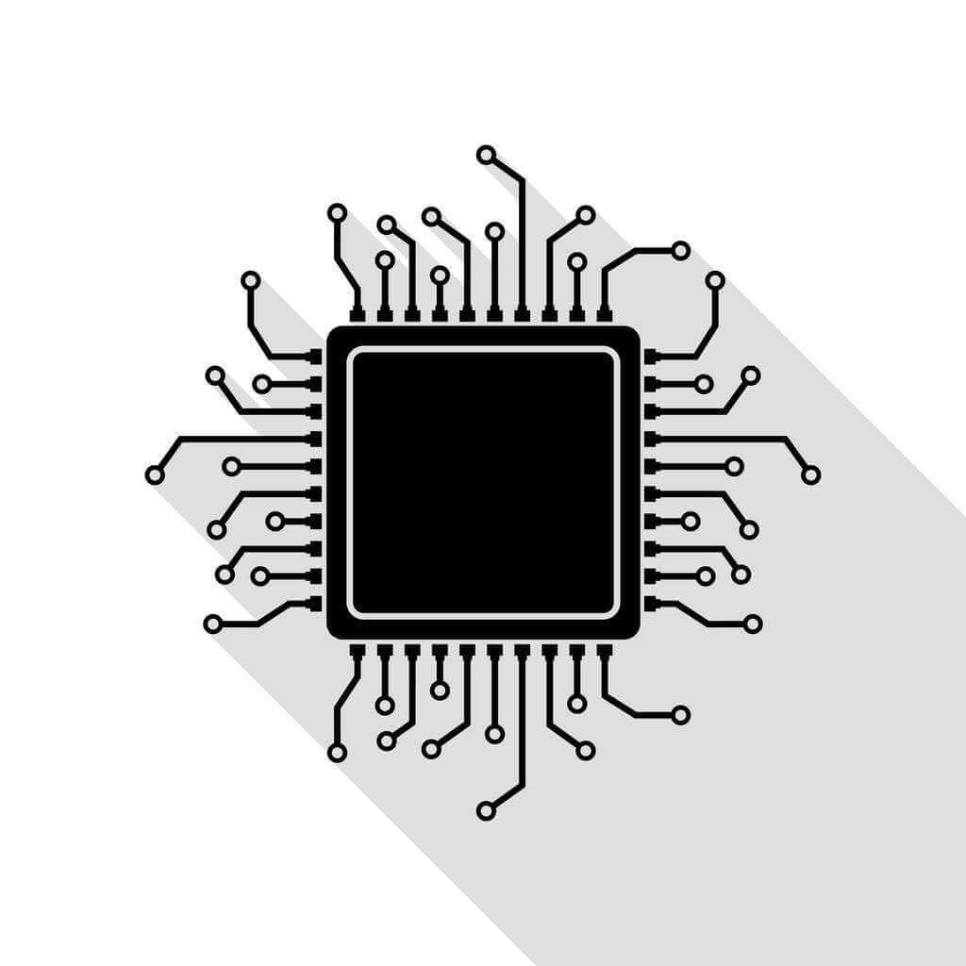
Hardware Software Codesign
Vipin Kizheppatt
02/08/2024

Slide 2
Course Management
Lecture
Monday, Wednesday, Friday 10 AM
Lab
Reconfigurable Computing lab
Tuesday, Thursday
Instructor
Vipin Kizheppatt
D212, EEE Department
Consultation: Tuesday 4:00-5:00 PM

Slide 3
Course Objectives
You should be able to design and implement moderate to complex IPs with standard bus interfaces such as AXI4, AXI-Stream etc.
You should be able to develop drivers for the IP blocks
You should be familiar with embedded Linux and real-time operating systems
You should be able to design moderately complex IP blocks using high-level synthesis (HLS)

Slide 4
Prerequisites
You should be quite familiar with Verilog HDL (https://youtube.com/playlist?list=PLXHMvqUANAFPO4id07GQggl64FS06TYWN&si=AsMSry7wNRfW1GCe)
You should be quite familiar with C/C++ programming language
(https://youtube.com/playlist?list=PL98qAXLA6aftD9ZlnjpLhdQAOFI8xIB6e&si=1NN6e6zOklZDiEe0)
You should have strong background in digital circuit design
You should have a good understanding of computer organization/architecture

Slide 5
Evaluation Components
EC No. | Evaluation Component | Duration (min) | Weightage (%) | Date & Time | Nature of Component
1. | Mid Sem | 1.5 hrs | 20 | 8/10/24 (11:00-12:30) | Closed Book
2. | Lab/assignment | - | 20 | To be announced | Open Book
3. | Project and Viva | - | 20 | To be announced | Open Book
4. | Lab Comprehensive | 5 hrs | 25 | To be announced | Open Book
5. | Comprehensive (Theory) | 2 hrs | 15 | 11/12/24 (AN) | Closed Book

Slide 6
Software
Software is composed of code and data
Code corresponds to set of instructions supported by a processor
Data corresponds to registers and memory locations used by the code during execution

Slide 7
Software
Aim → Add 20H and 30H and store the result in memory
C Code Assembly Code Hex Code
char a=20; MOV A,#20 3E 20
char b=30; MOV B,#30 06 30
char c;
c = a+b; ADD A,B 80
MOV [000A],A 32 0A 00

Slide 8
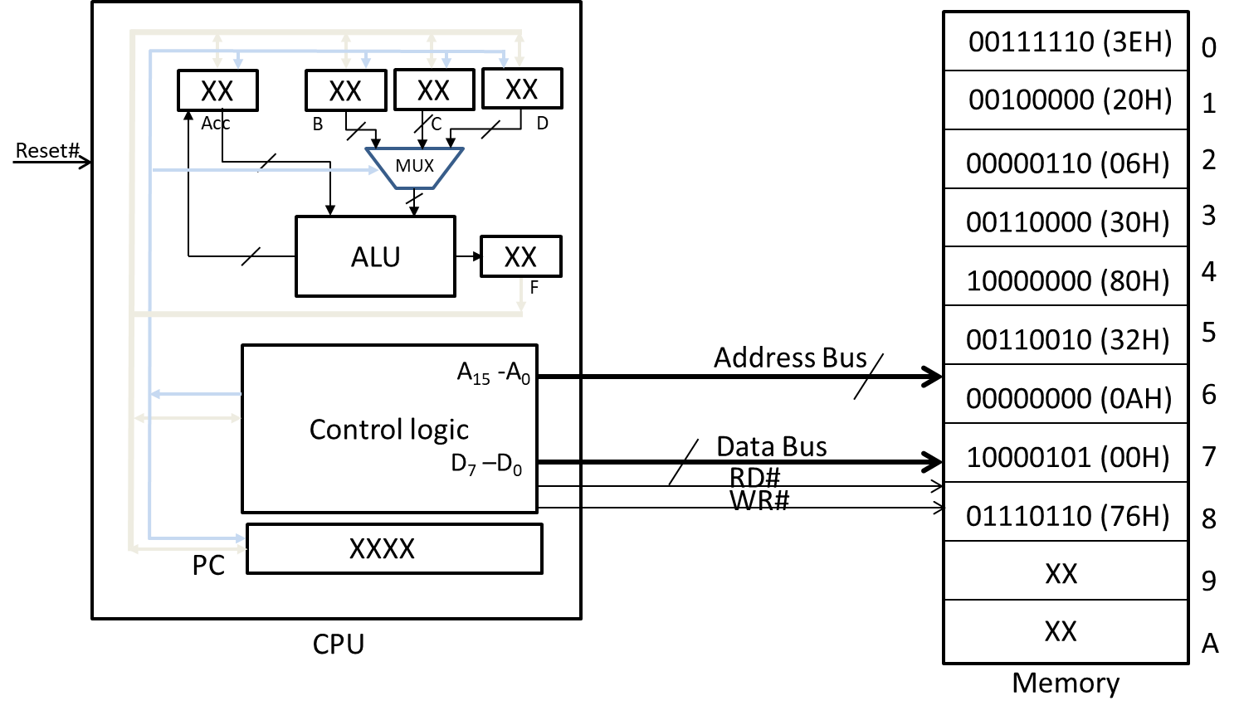
Software
Modern computers use a stored-program model for program execution

Slide 9
Software
Software does not exist without hardware!!
In software-based systems, applications are implemented as different set of instructions (software) mapped to the same hardware architecture
This is the greatest advantage of software also → flexibility
For implementing a new application, same hardware can be used with a different set of instructions
Converting software written in a high-level language to machine language (compilation) is also a fast process

Slide 10
Software
How fast a software-based system executes depend upon several factors
Roughly it can be mapped to the number of instructions, number of clock cycles per instruction and the clock frequency at which the processor runs
execution Time = #instructions x clock cycle/instruction x clock period
Practically we cannot keep on increasing clock frequency or reduce clock cycle/instruction

Slide 11
Software
Another limiting factor of software implementation is power consumption
In stored program model, often data/instruction needs to be fetched from external memory
Inter-chip communication is one of the most power consuming operation (due to large driving current)
Again since applications need to be mapped to a fixed hardware architecture, implementation may be suboptimal increasing execution time and power consumption

Slide 12
Hardware
Hardware (here we are dealing only with digital circuits) and built using gates and flip-flops
The major advantage of hardware is it can be custom designed for a specific application
This increases their performance (throughput) and power consumption compared to a software implementation
But hardware is inherently inflexible
Their design and development process is more complex and takes more time compared to software counterpart

Slide 13
Hardware-Software
In a hardware-software co-design approach we try to exploit advantages of both domains
As a thumb rule, hardware is very efficient in implementing data intensive applications (usually referred as data path)
Software is more appropriate for control intensive applications (usually referred as control path)
In a codesign approach, we implement data processing portion of the system on custom hardware and use software to control them

Slide 14
Thank you any questions

